Slide 1
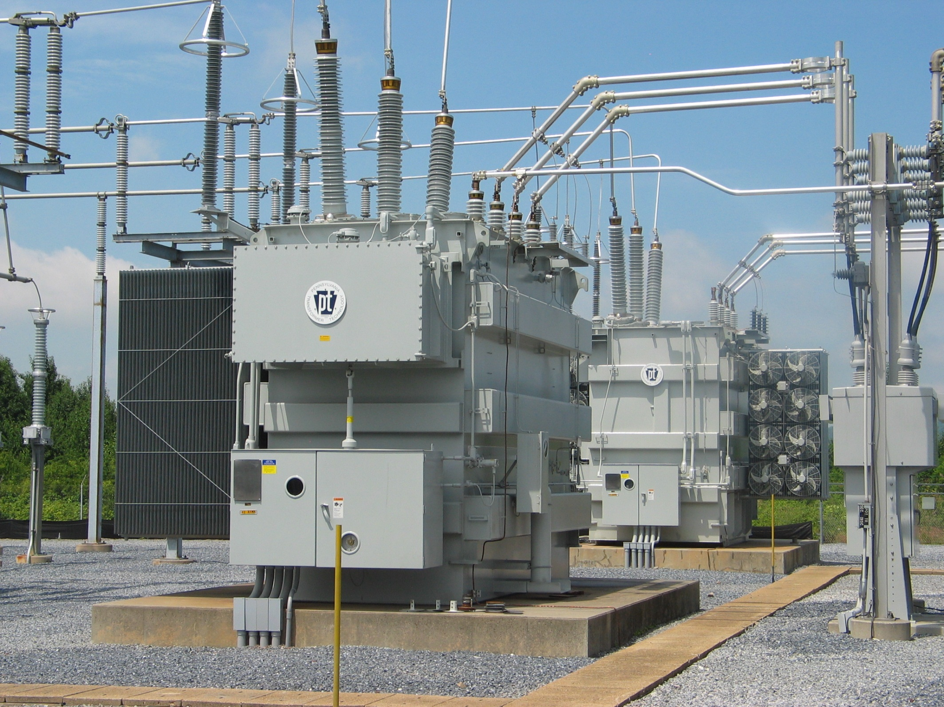

Slide 2
History
PENNSYLVANIA TRANSFORMER 1929-1952 Co-founded by Samuel Horelick/William Kerr
McGRAW ELECTRIC 1952-1957
McGRAW-EDISON 1957-1985
COOPER POWER SYSTEMS 1985-1996
PENNSYLVANIA TRANSFORMER TECHNOLOGY, INC 1996-Present PTTI purchased ALL intellectual & physical assets from Cooper Power Systems' medium & large power transformer product lines

Slide 3
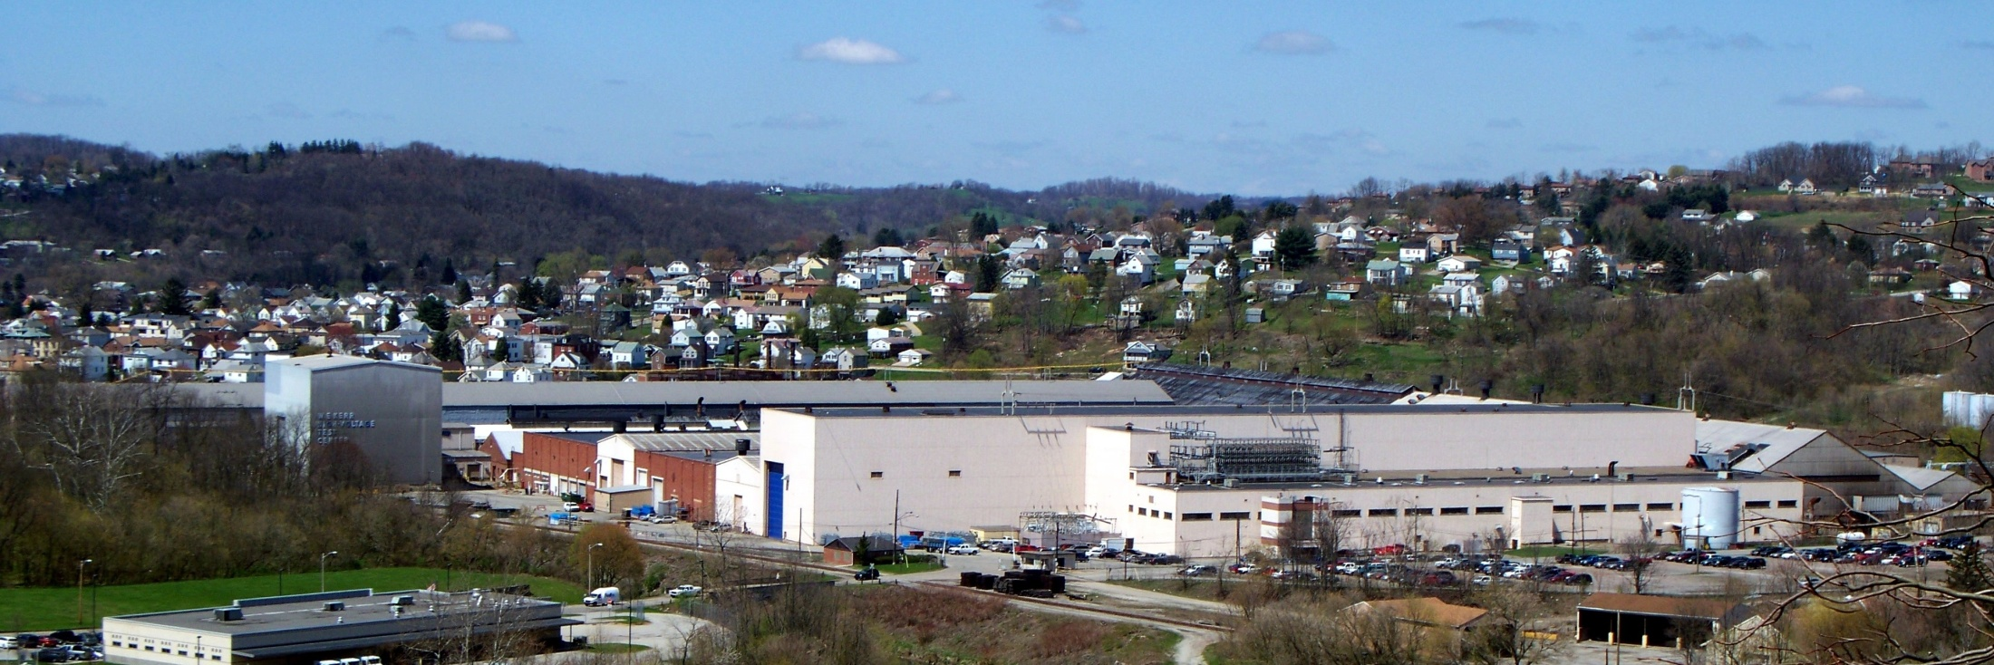
Canonsburg Capabilities
Ratings
Maximum Voltage Rating – 345kV
Maximum BIL – 1050kV
Maximum Power - 600MVA (top rating)
Manufacturing
Testing – 2400kV BIL
Lifting – 1 million pounds
Capacity – 80 to 100 units per year
Employees – 300

Slide 4
Blanket Transformer Awards
Customer | MVA | Voltage | Duration | Qty
DTE | 24/32/40 | 120kV-13.8kV LTC | 2001 – Present | 75
DTE | 60/80/100 | 120kV-46kV LTC | 2001 – Present | 24
FPL | 33/44/55 | 230kV-24kV | 1998 – Present | 101
FPL | 33/44/55 | 138kV-13.8kV LTC | 2006 – Present | 15
Allegheny Power | 21/28/35 | 135.3kV-13.09kV LTC | 2001 – 2010 | 48
Amtrak | 4.5 – 1 ph | 138kV-13.8kV 25Hz | 2003 – Present | 73
Alabama Power | 24/32/40 | 115kV-46kV LTC | 2001 - Present | 16

Slide 5
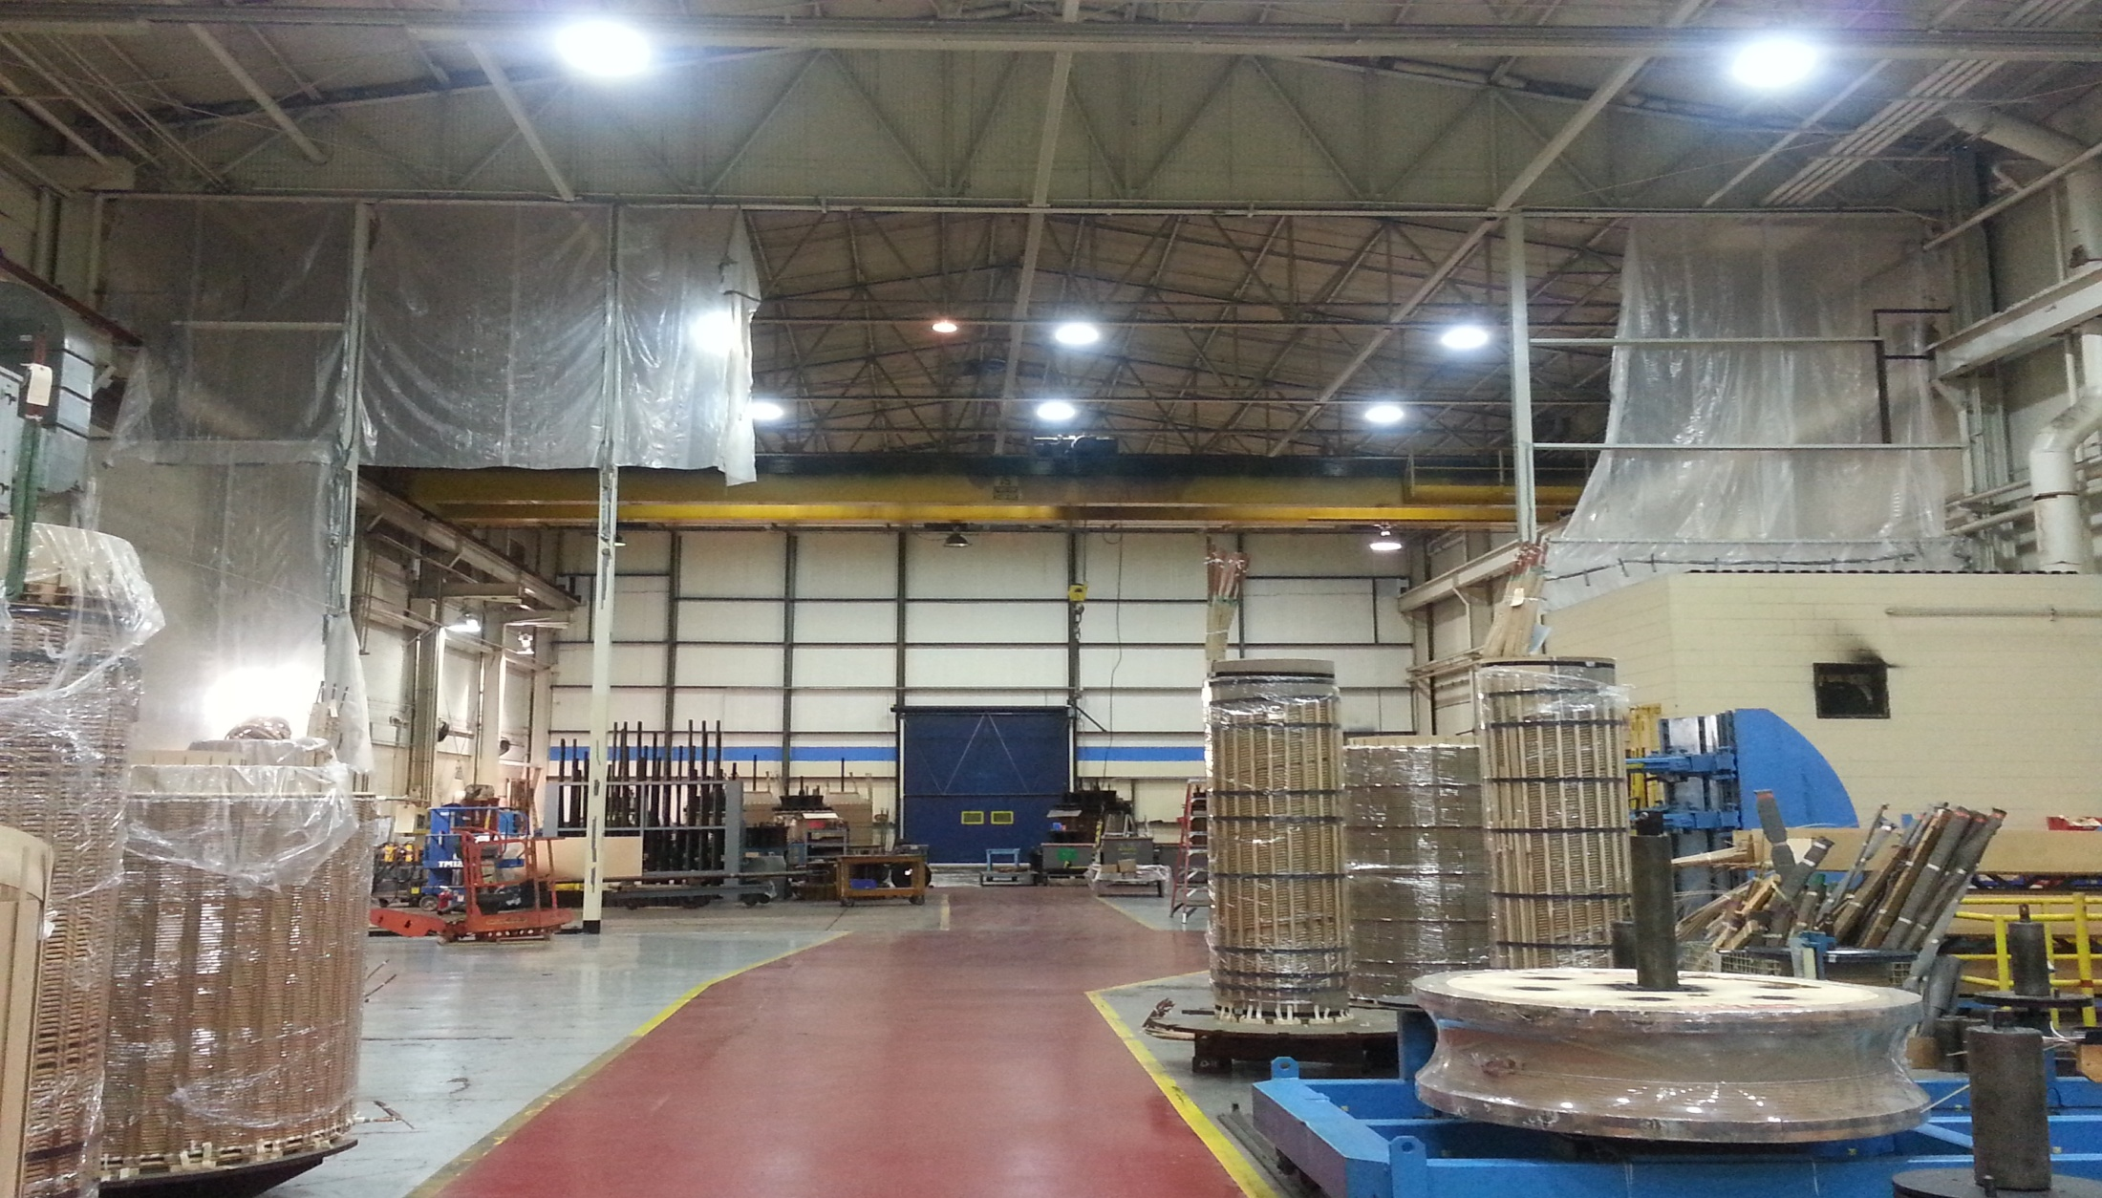
Canonsburg Investments
Expansion of Temperature-Controlled Winding Room
Expansion of Temperature-Controlled Winding Room

Slide 6
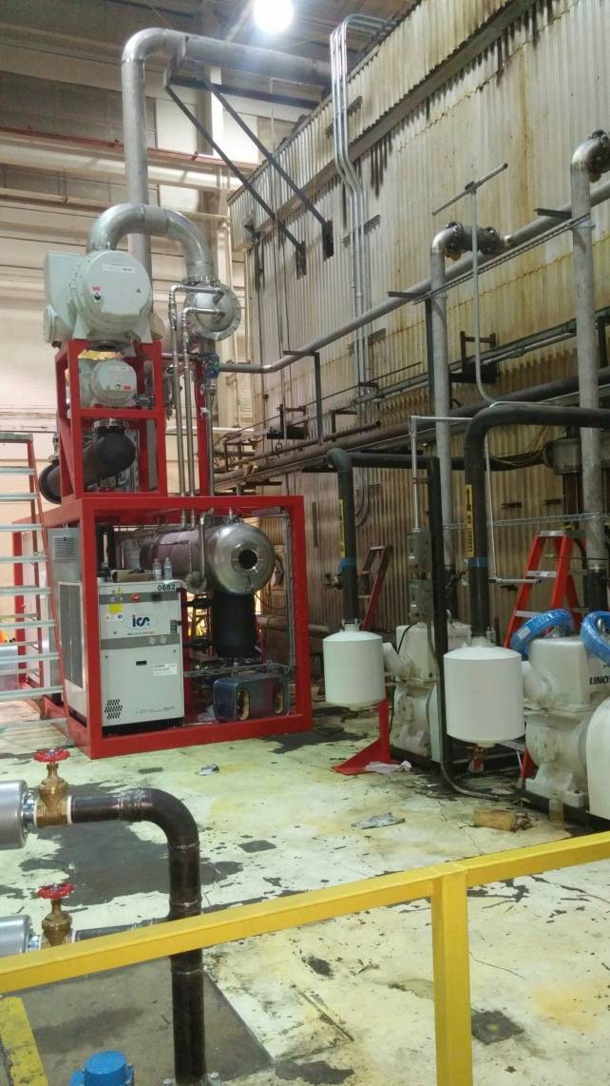
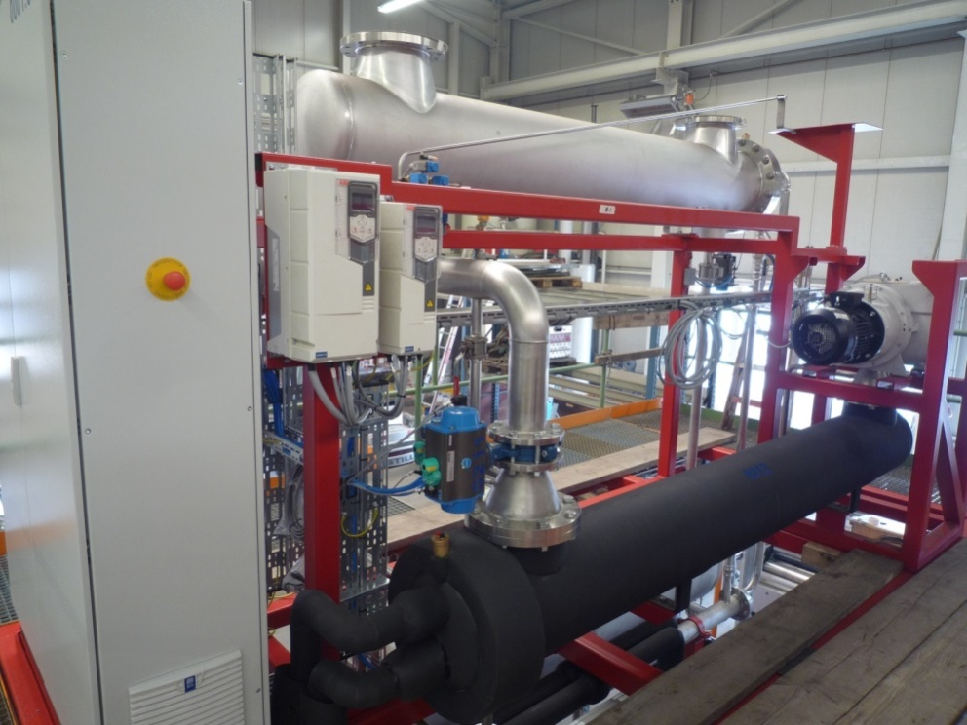
Canonsburg Investments
Expansion of Temperature-Controlled Winding Room
Vapor Phase Autoclave/Controls Upgrade

Slide 7
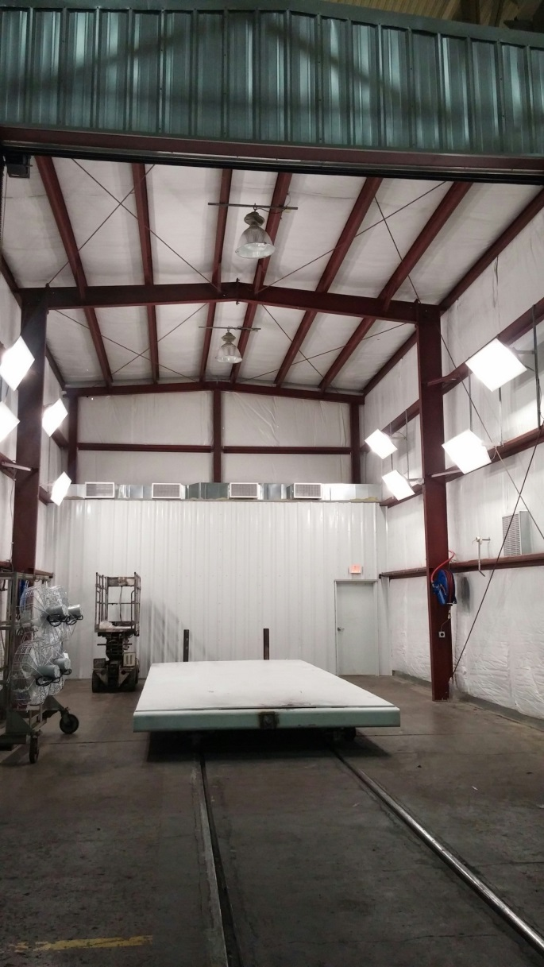
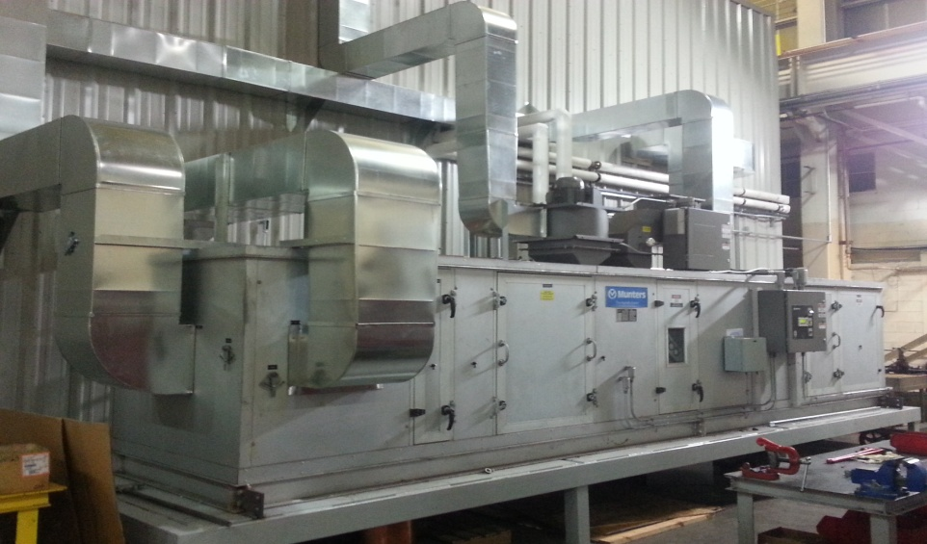
Canonsburg Investments
Expansion of Temperature-Controlled Winding Room
Post Vapor Phase Dry Room

Slide 8
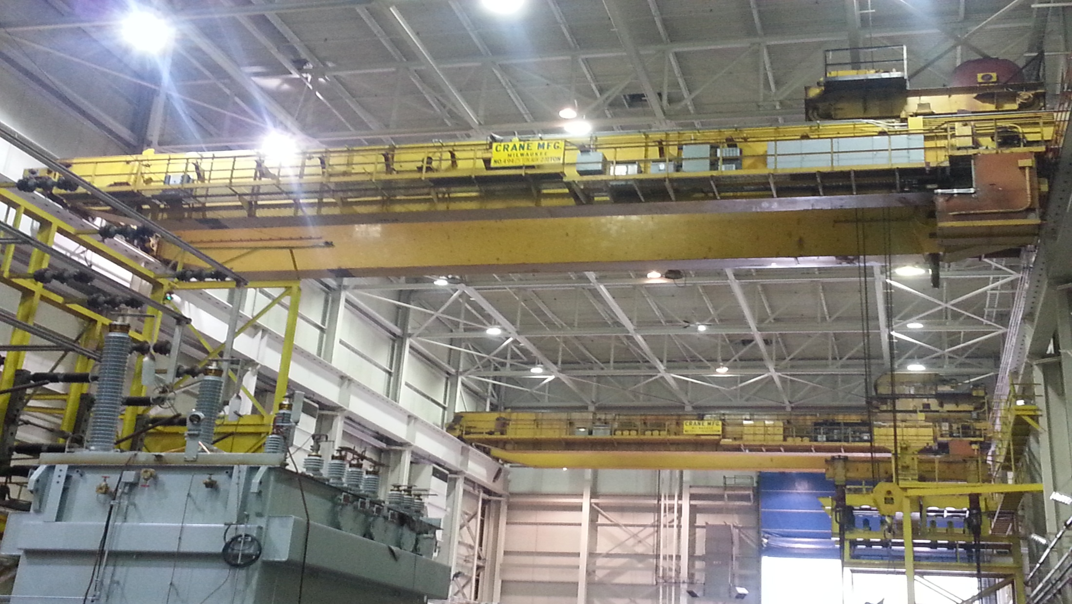
Canonsburg Investments
Expansion of Temperature-Controlled Winding Room
Big Crane Refurbishment

Slide 9
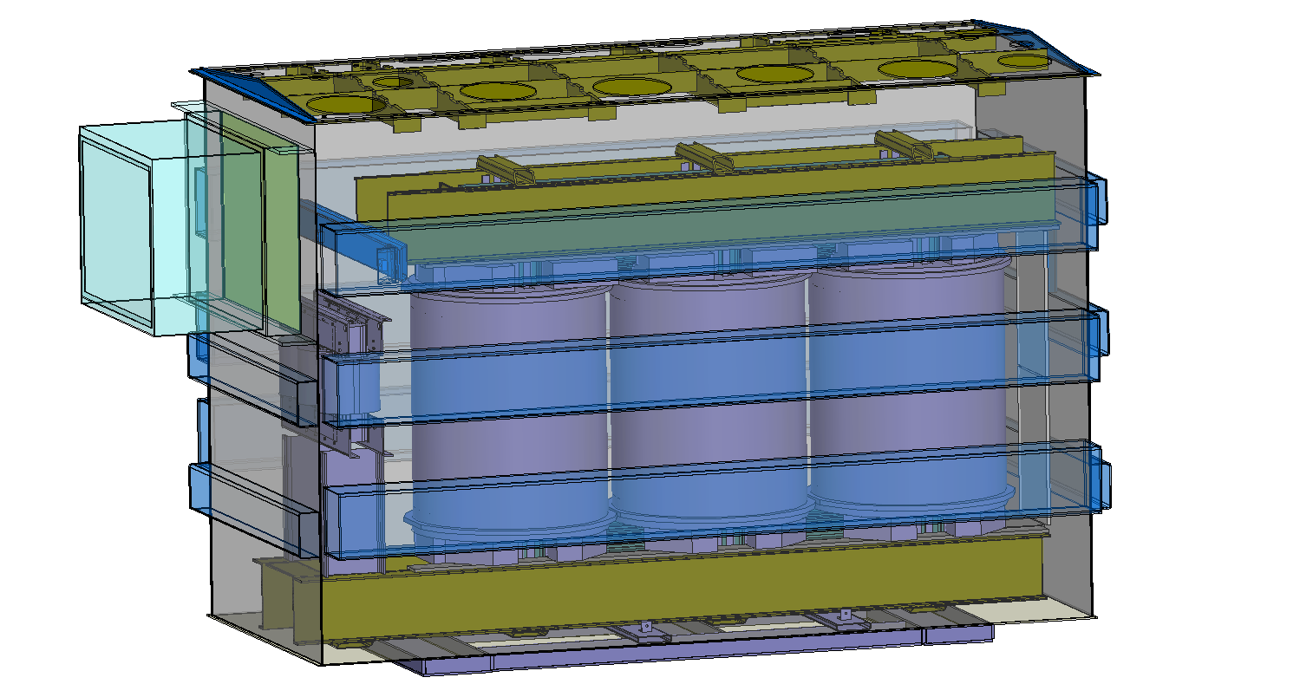
Design Engineering Programs
FEA Analysis for tank wall and side frame heating
Winding Transient Analysis – VLN transient program developed by VIT Ukraine
Short-Circuit Analysis
– Andersen
2D/3D CAD – Inventor 3D
and AutoCAD Electrical for
Control Wiring Drawings

Slide 10
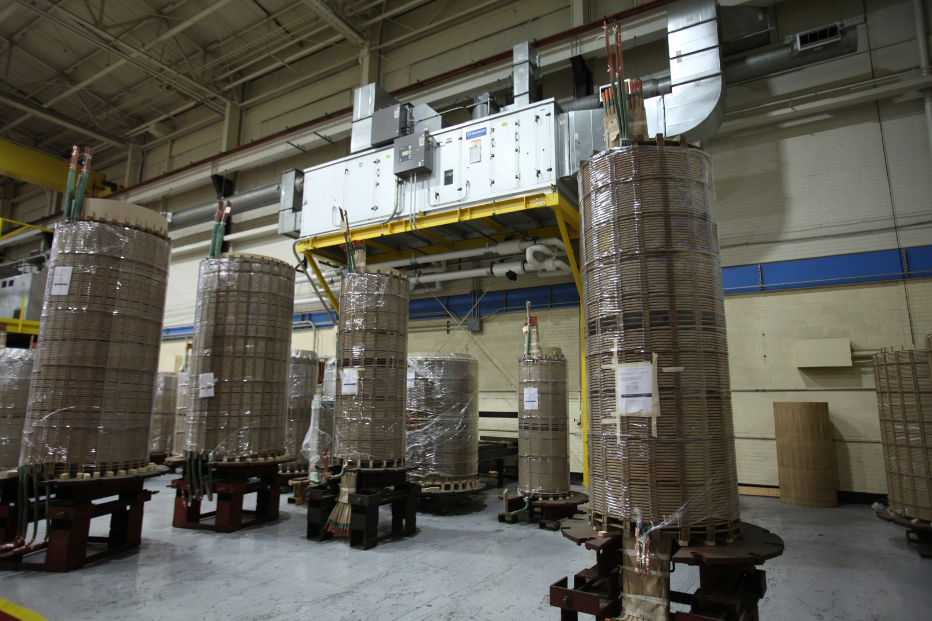
Winding Room
Humidity Controlled – Positive Pressure

Slide 11
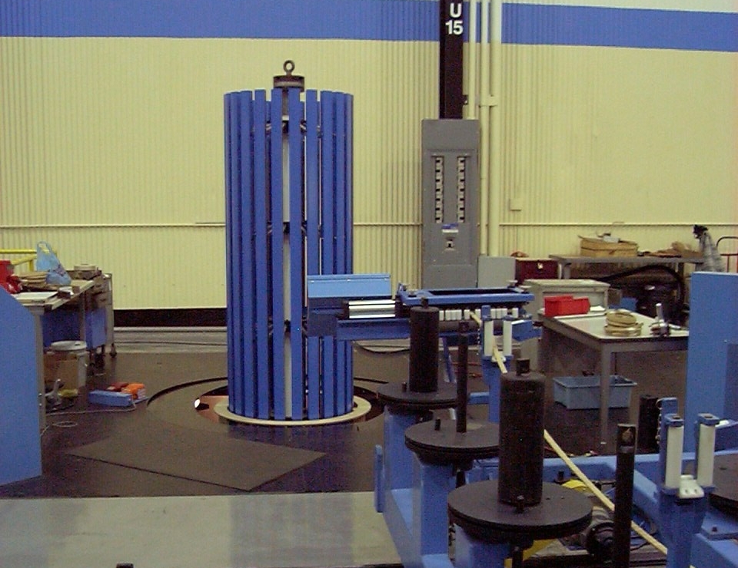
Winding Room
Six Vertical Winding Machines

Slide 12
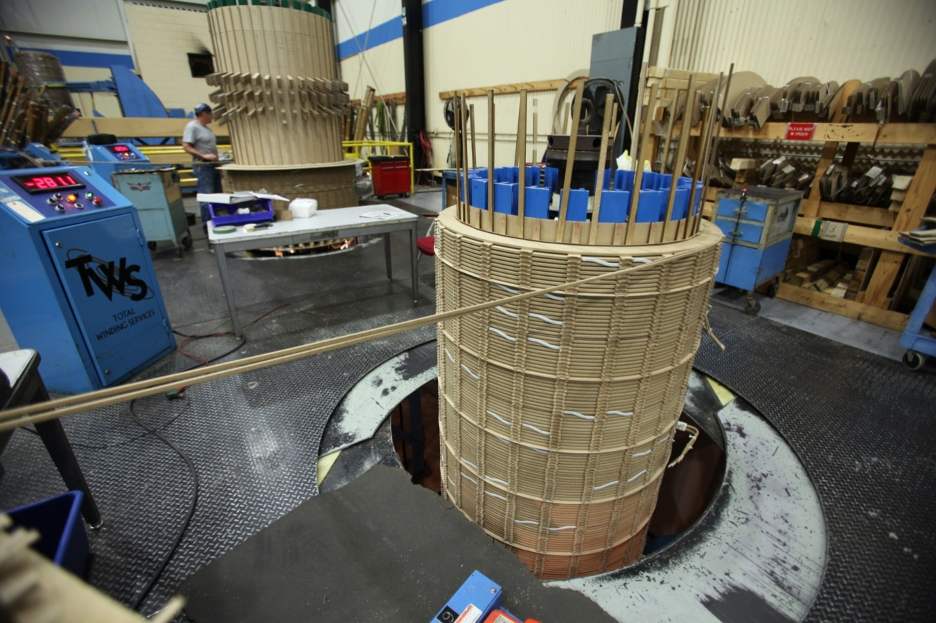
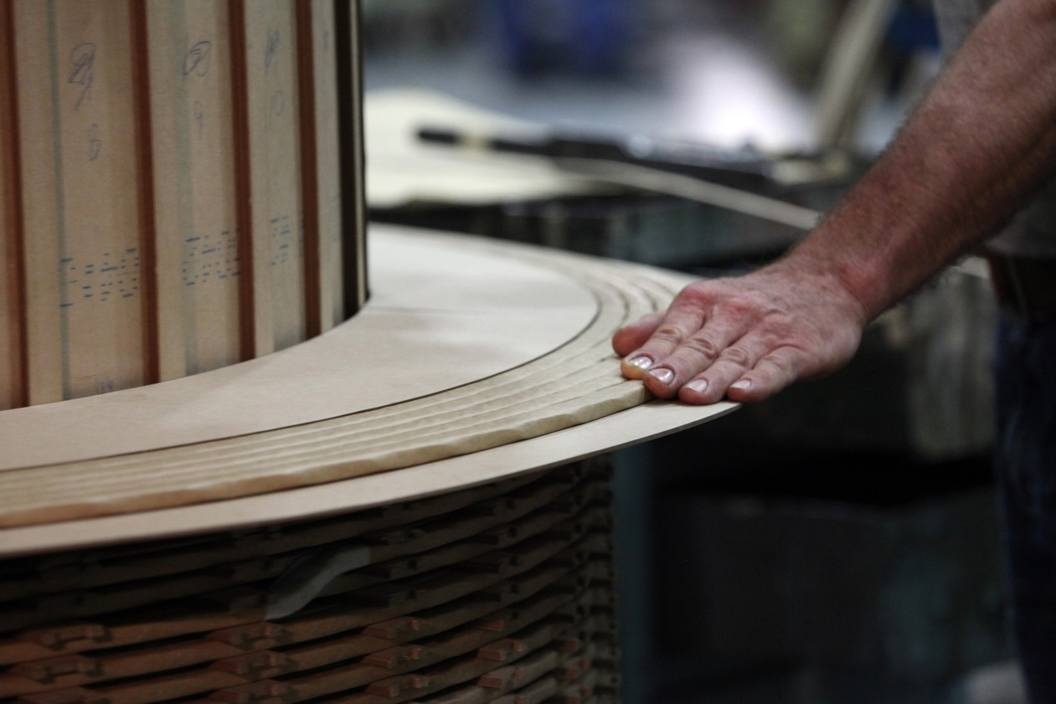
Winding Room
Six Vertical Winding Machines

Slide 13
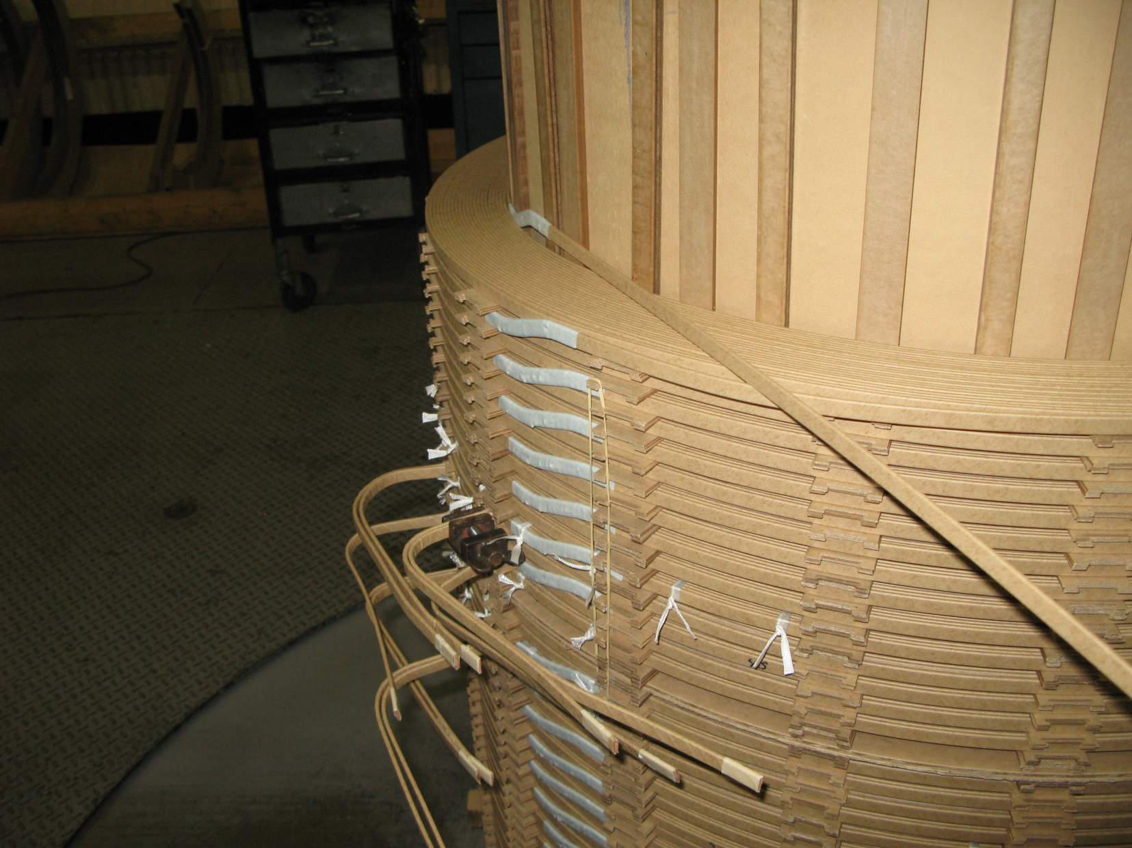
Winding Room
HV Coils
Disk Windings
Strand or CTC

Slide 14
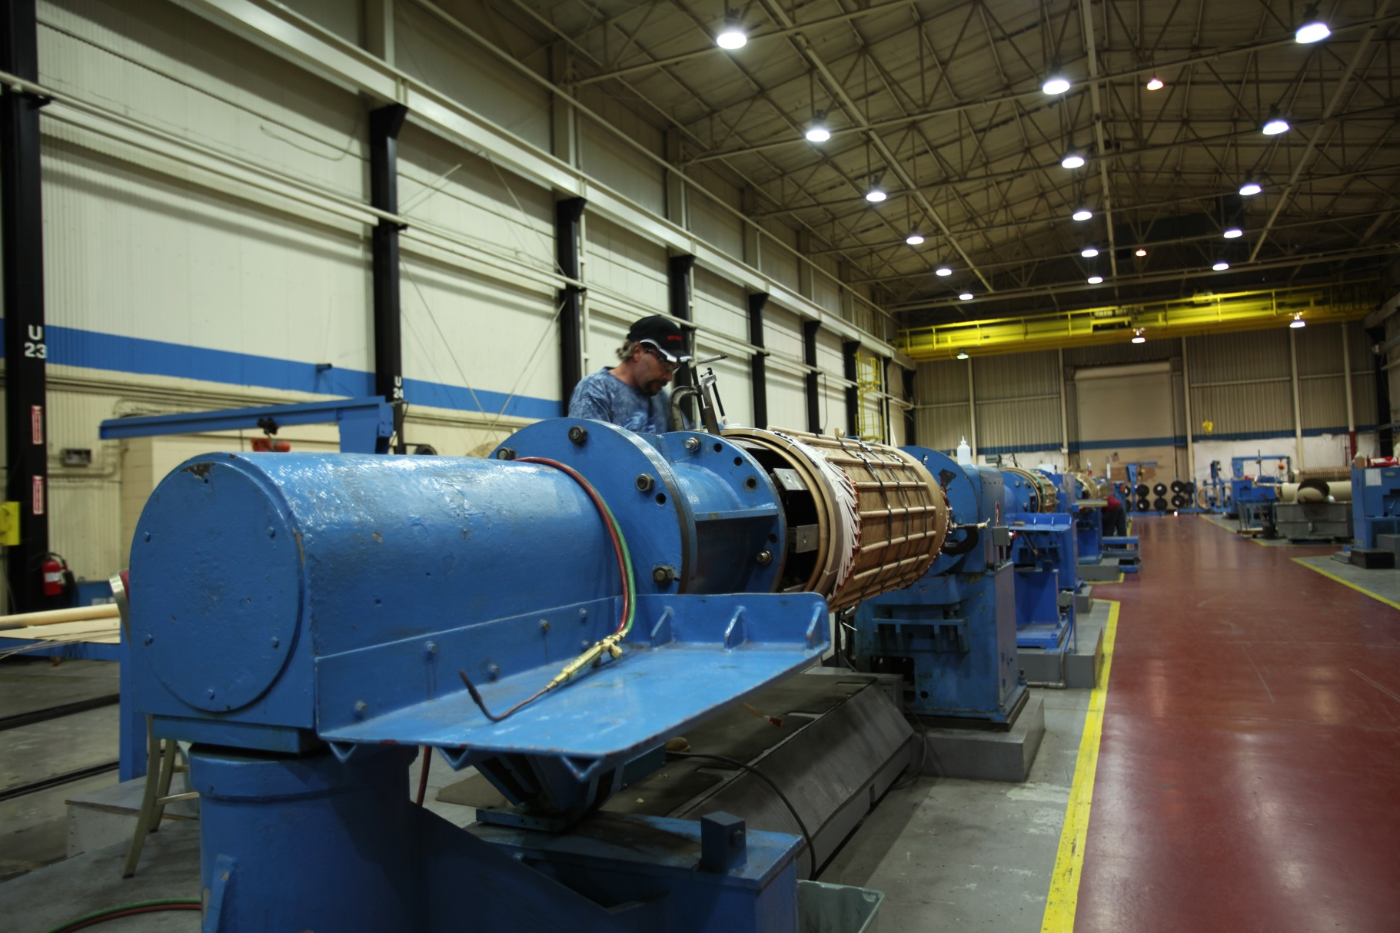
Winding Room
Nine Horizontal Winding Machines

Slide 15
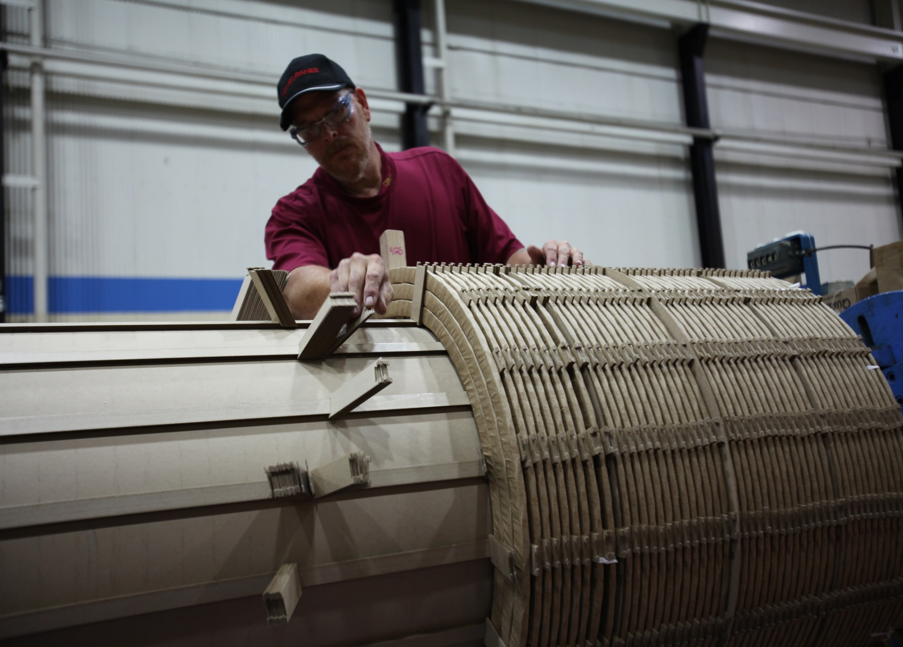
Winding Room
LV Helical with CTC

Slide 16
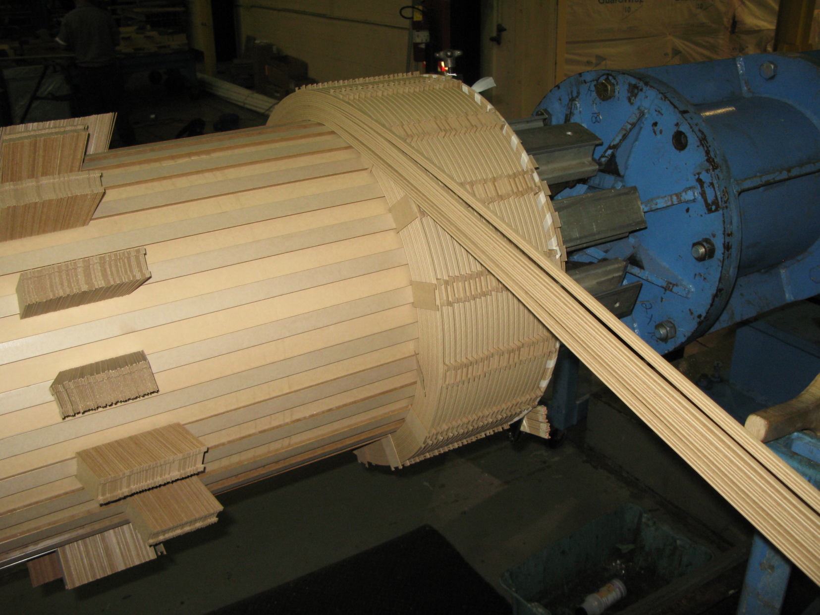
Winding Room
LV Helical with Strand Wire

Slide 17
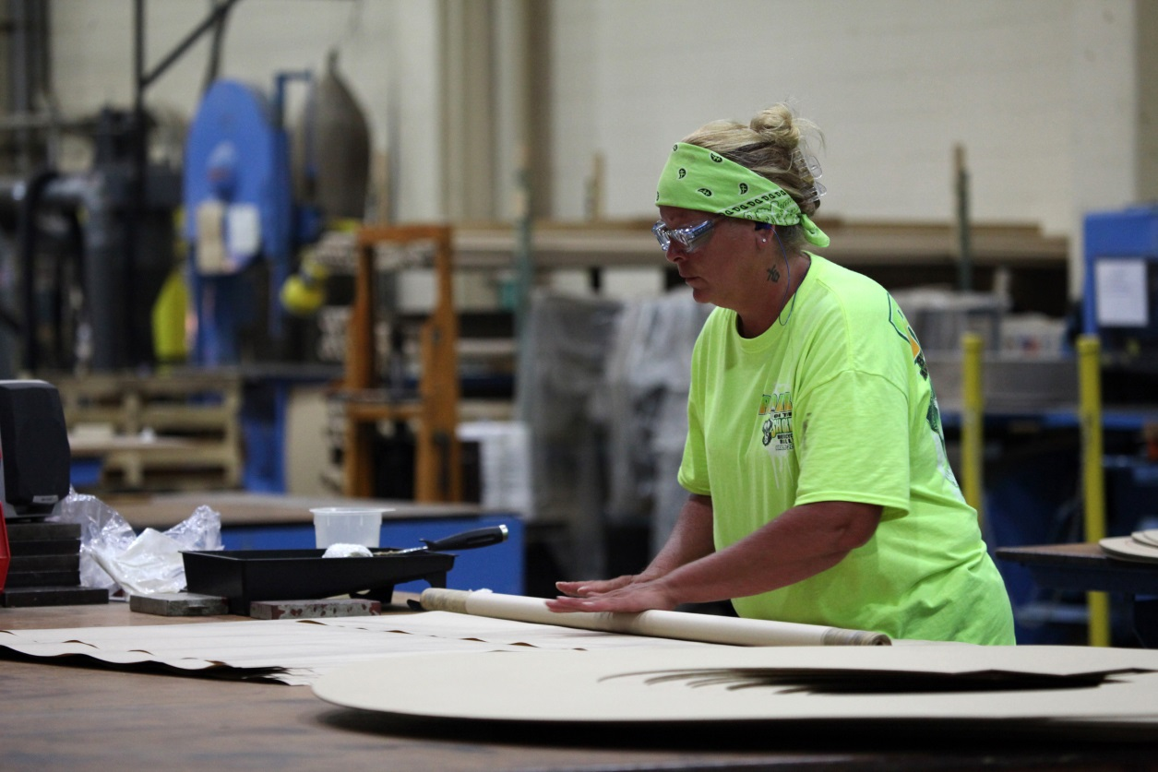
Insulation
In-House Fabrication
Phase-to-Phase Barriers
Hi-Lo Barriers
Coil Blocks
Lead Supports
Spacers
Purchased Parts
Winding Cylinders
Clamping Rings
Strips

Slide 18
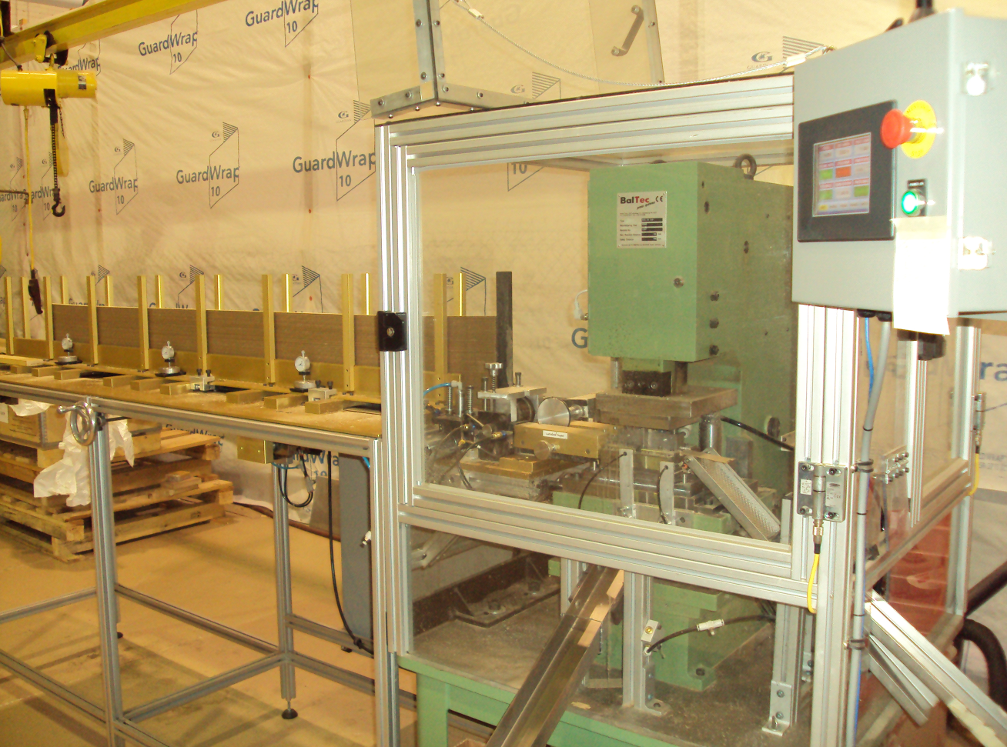
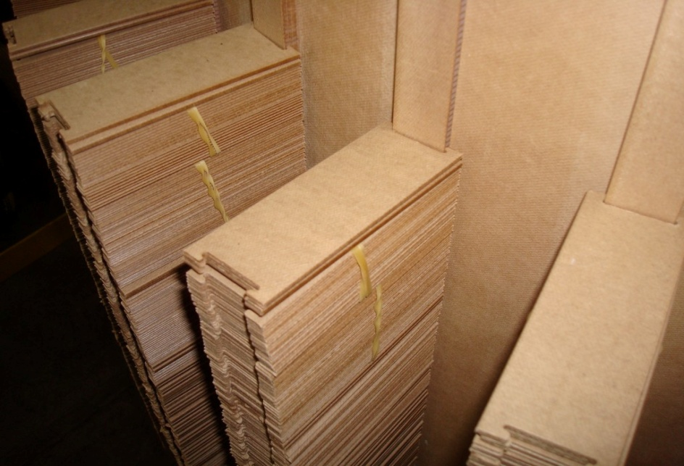
Insulation
PTTI Punches its Own Spacers

Slide 19
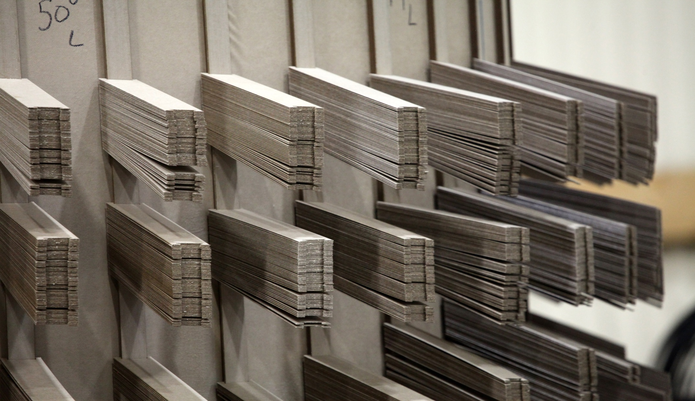
Insulation

Slide 20
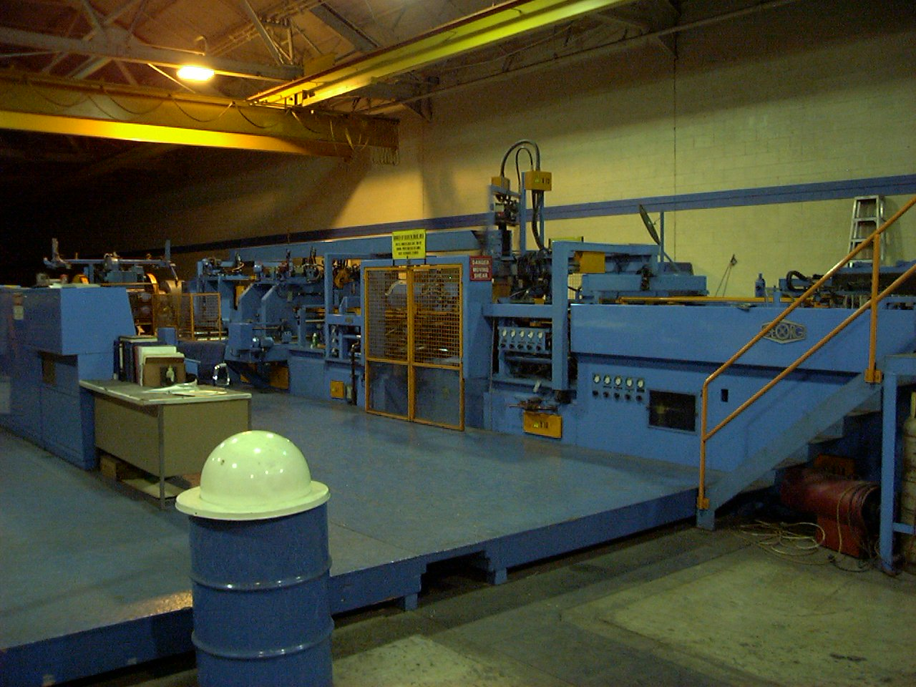

Cores
Cores are Stamped (Sheared)

Slide 21
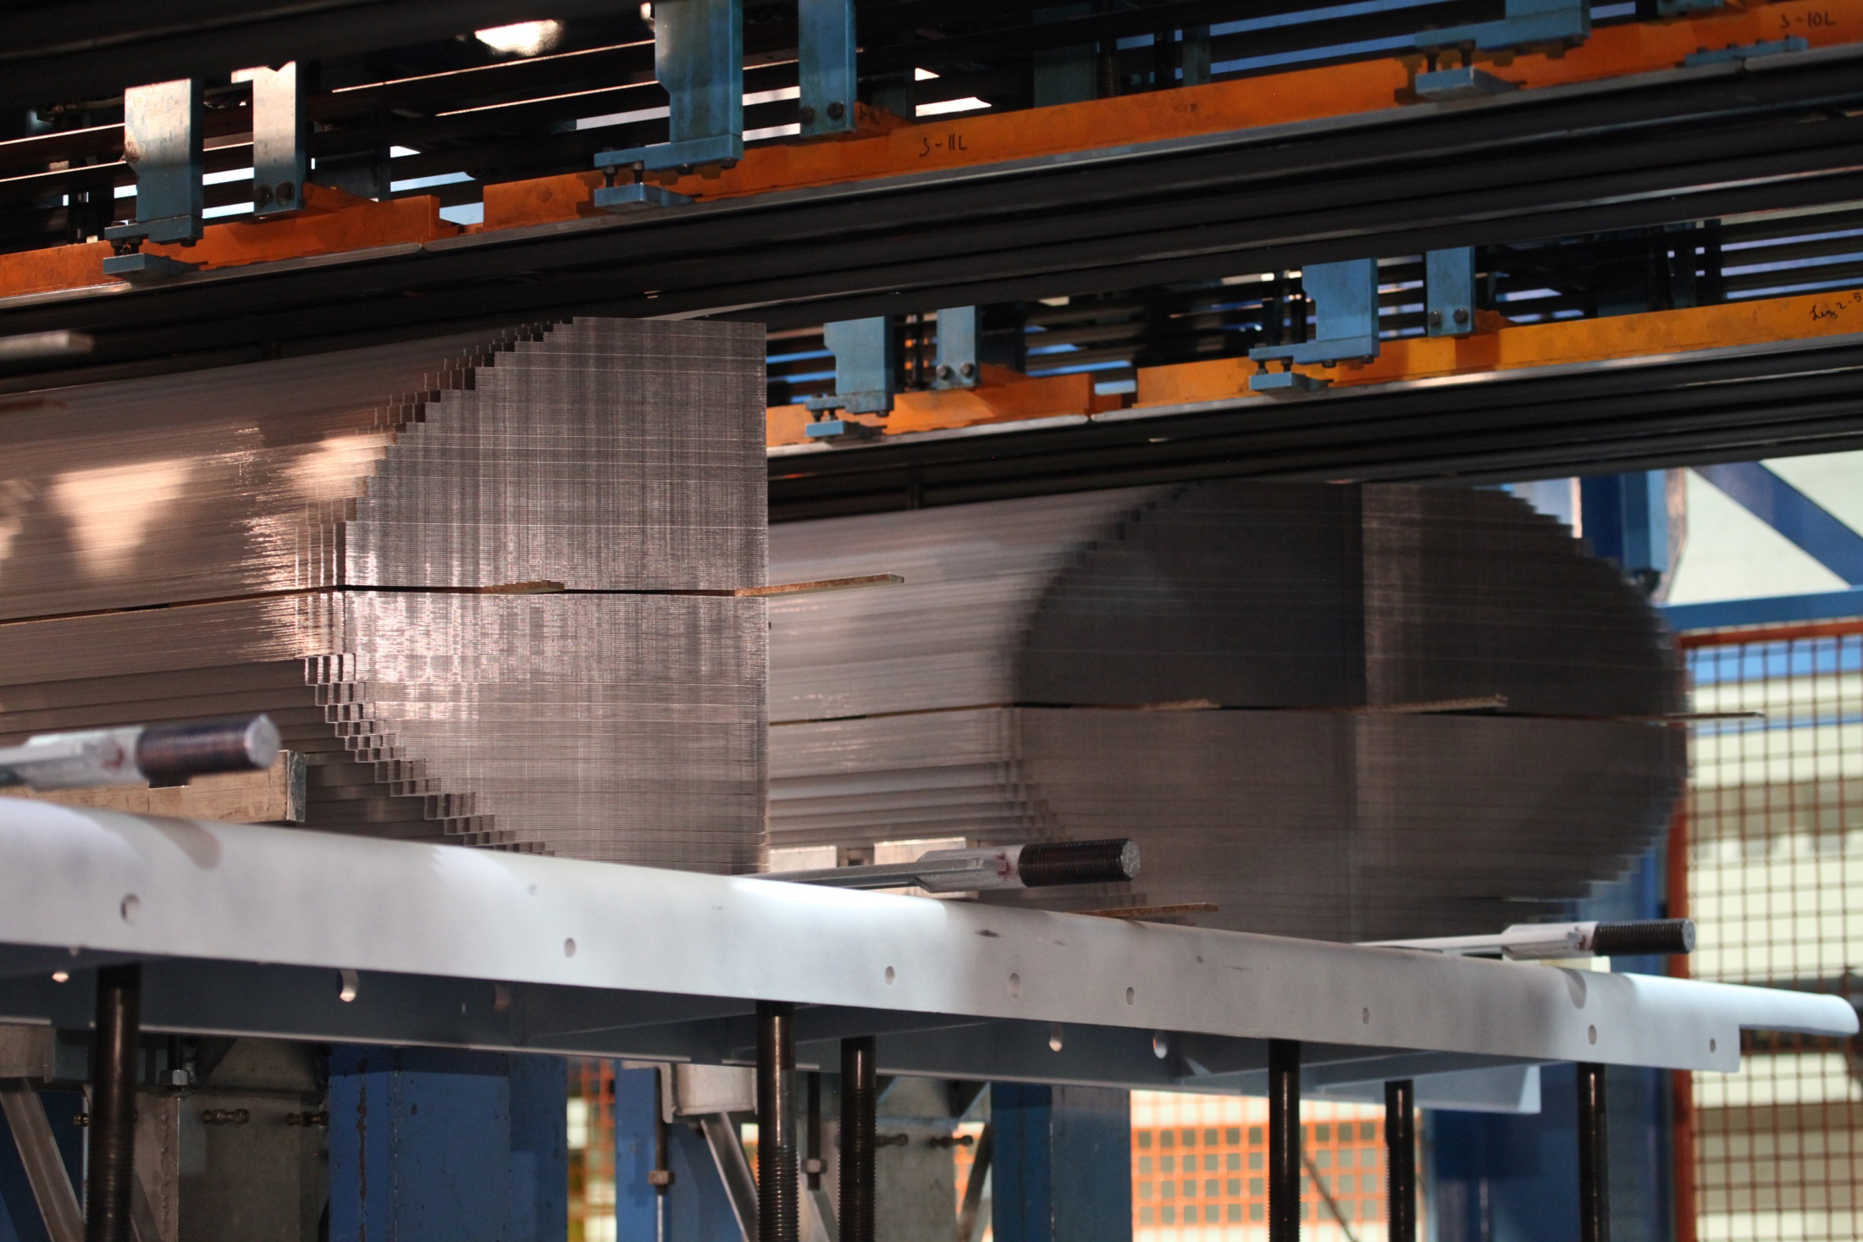
Cores

Slide 22
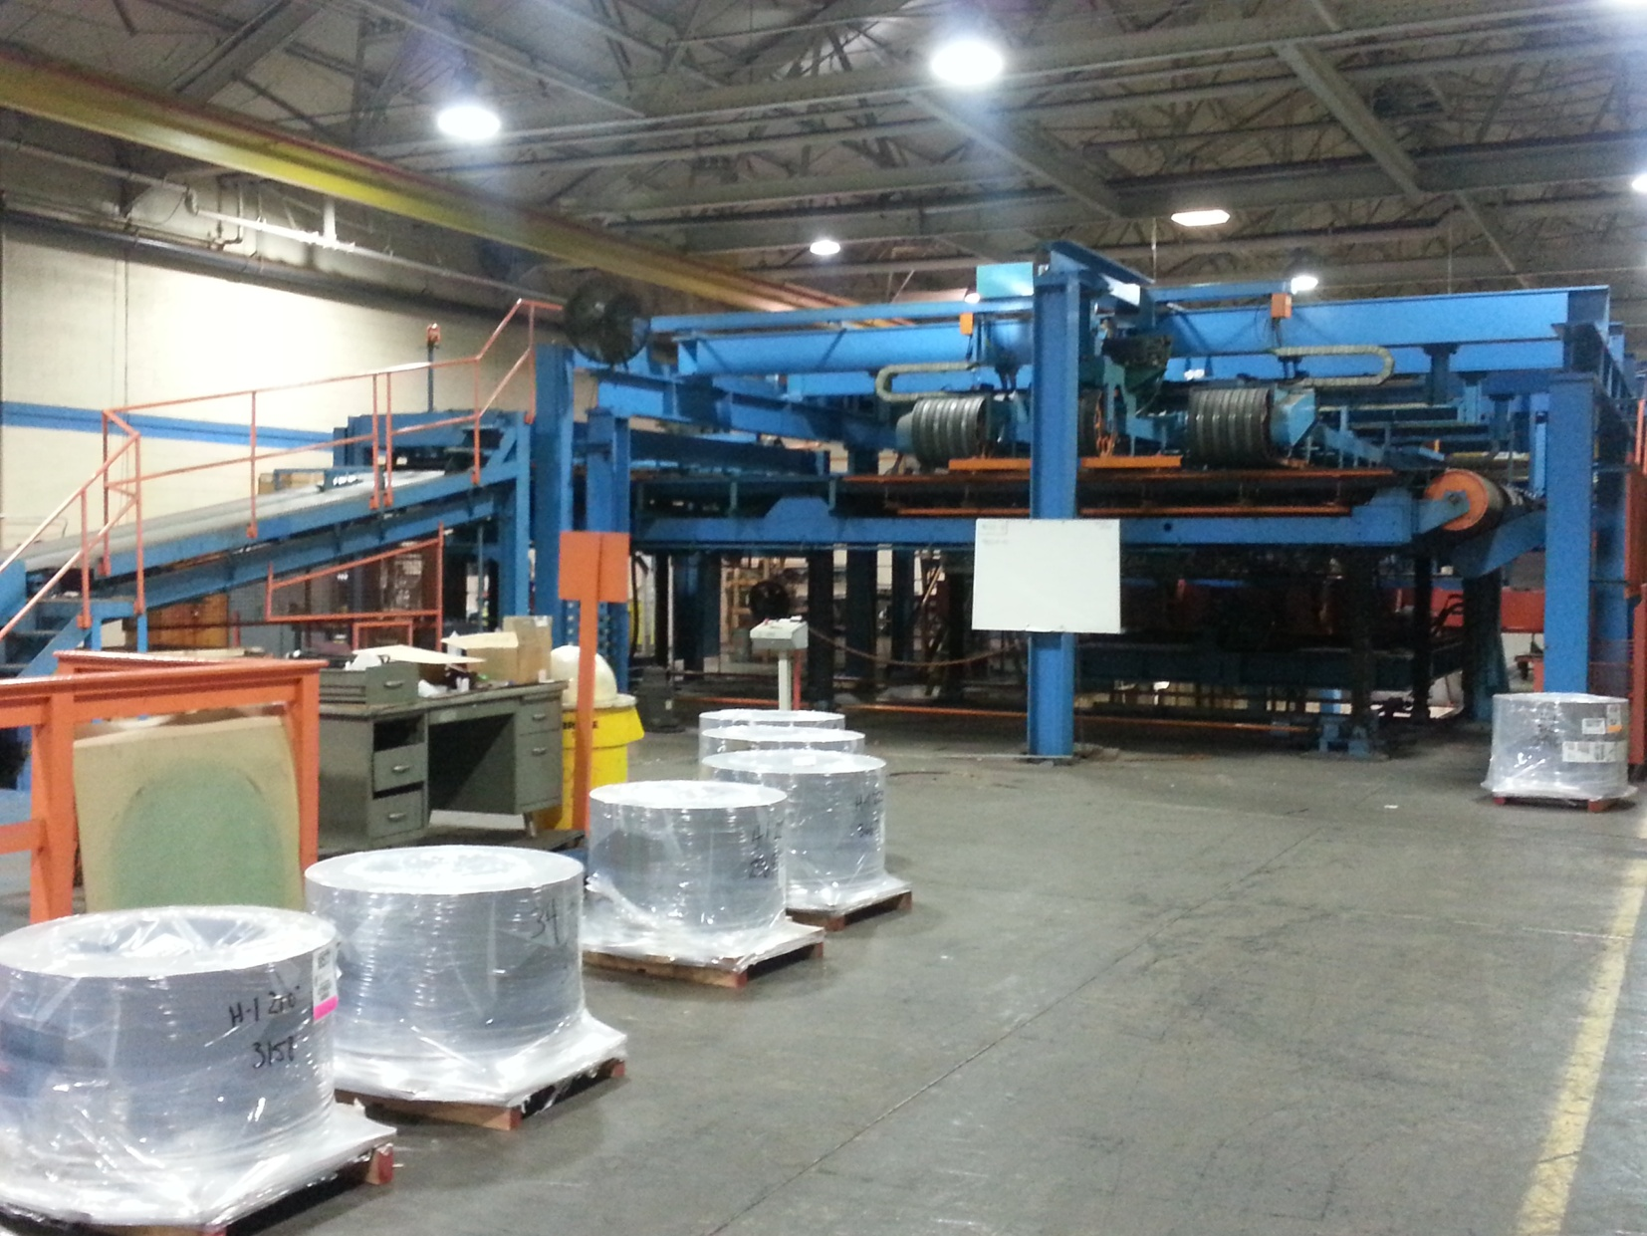
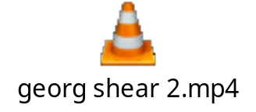
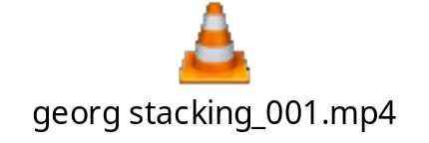
Cores
Automatic E-Stacked
Each Offset Measured in Height
No Variance

Slide 23
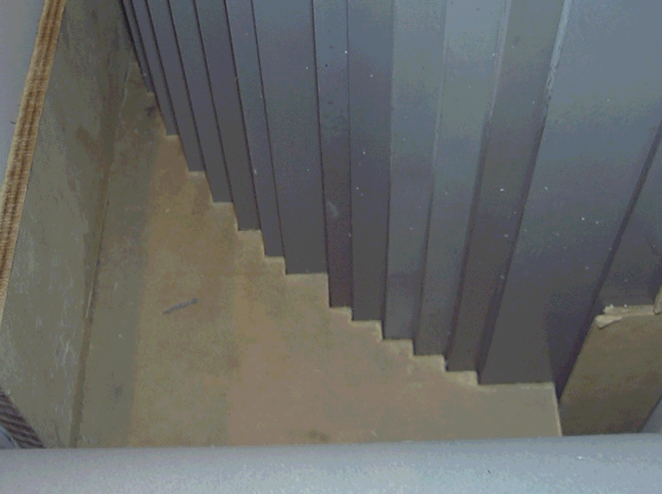
Cores
Perfect Fit
Core Block (Router)
and
Core
(E-Stacked)

Slide 24
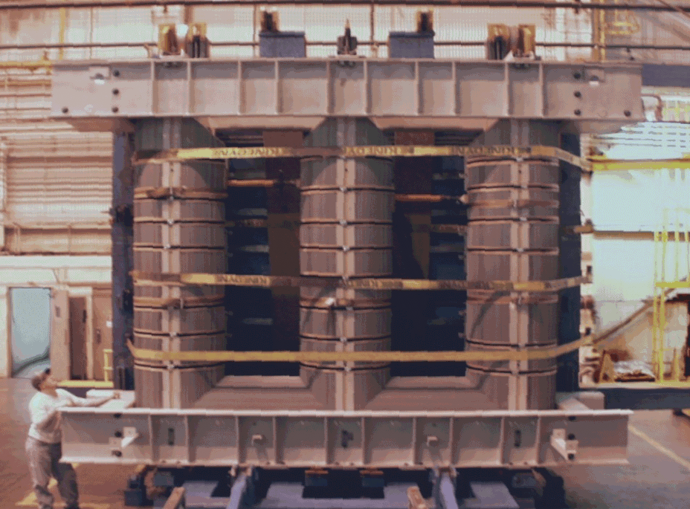
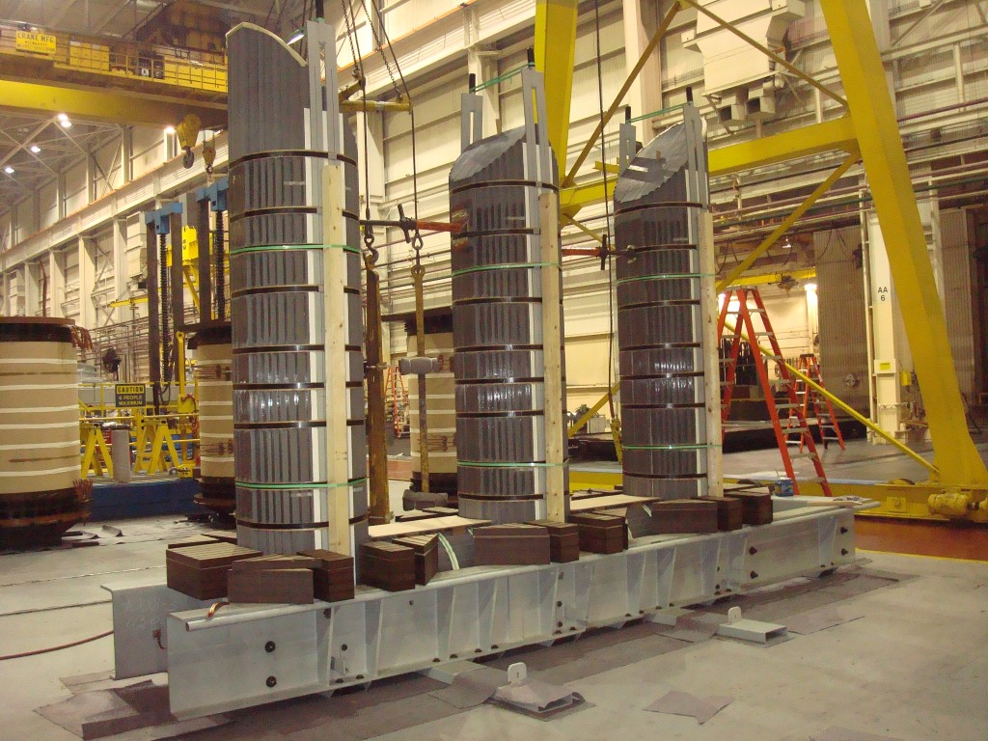
Cores
Cores Upended
250 MVA Core

Slide 25
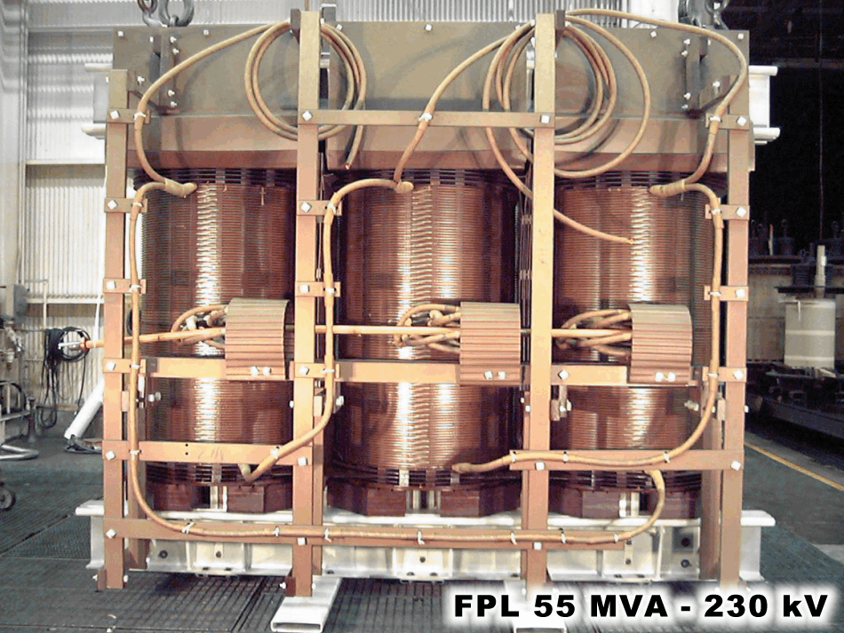
Core and Coil Assembly
Top Coil Insul
Phase Barrier Insul
Lead Support
Bottom Coil Insul

Slide 26
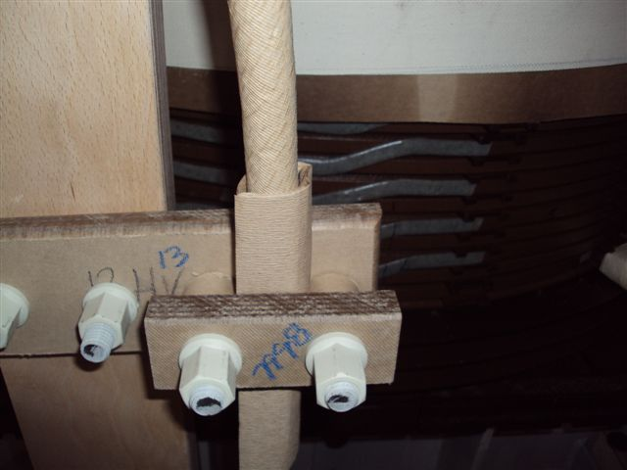
Core and Coil Assembly
Lignastone
Better Mechanical Strength
Transformer Board TX
Better Dielectrics for Lead Runs

Slide 27
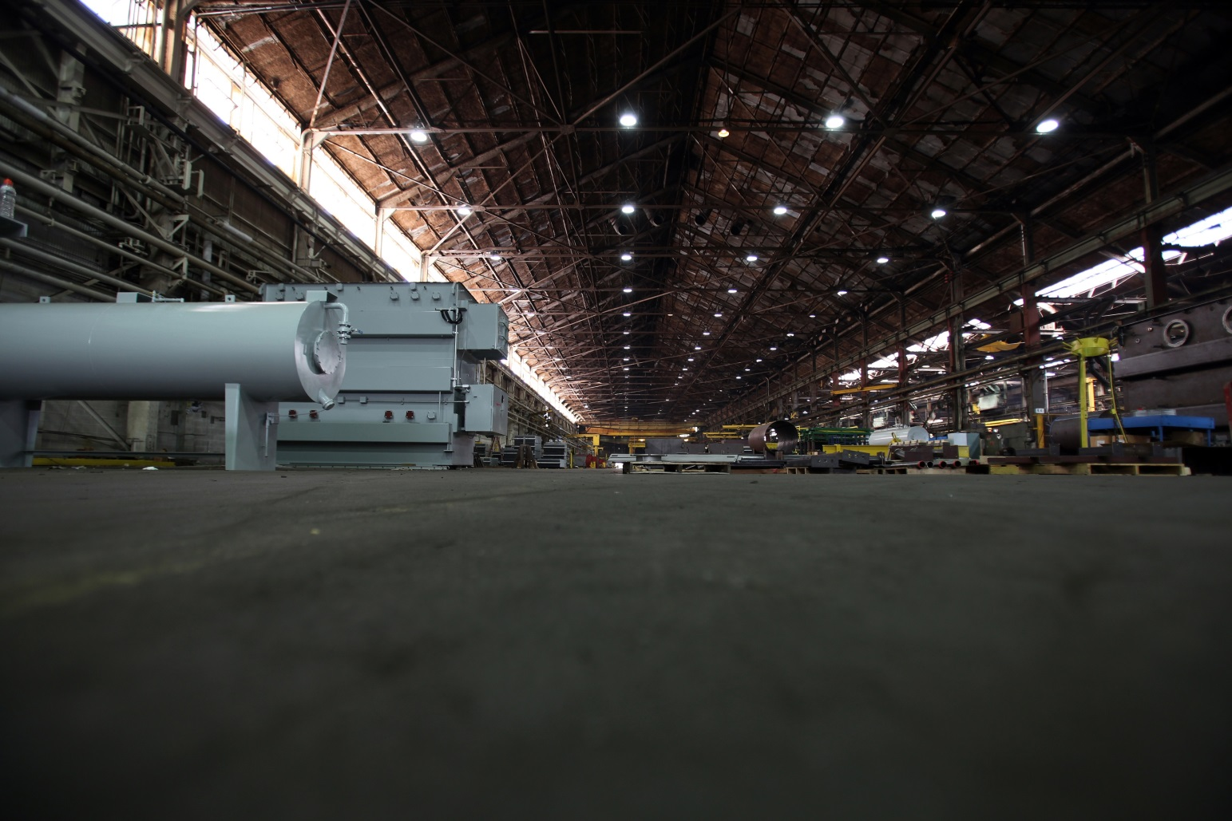
Tanks
Tank Manufacturing - 200,000 sq ft Tank facility

Slide 28
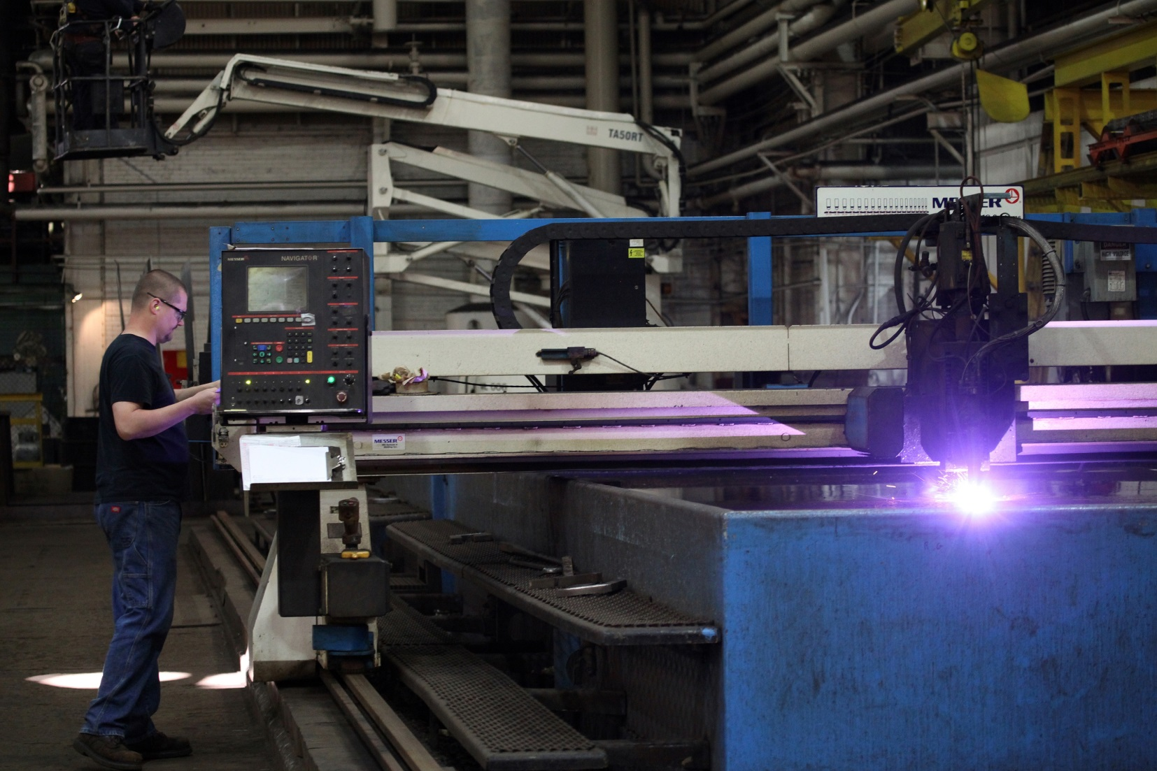
Tanks
Tank Manufacturing
CNC Burning table

Slide 29
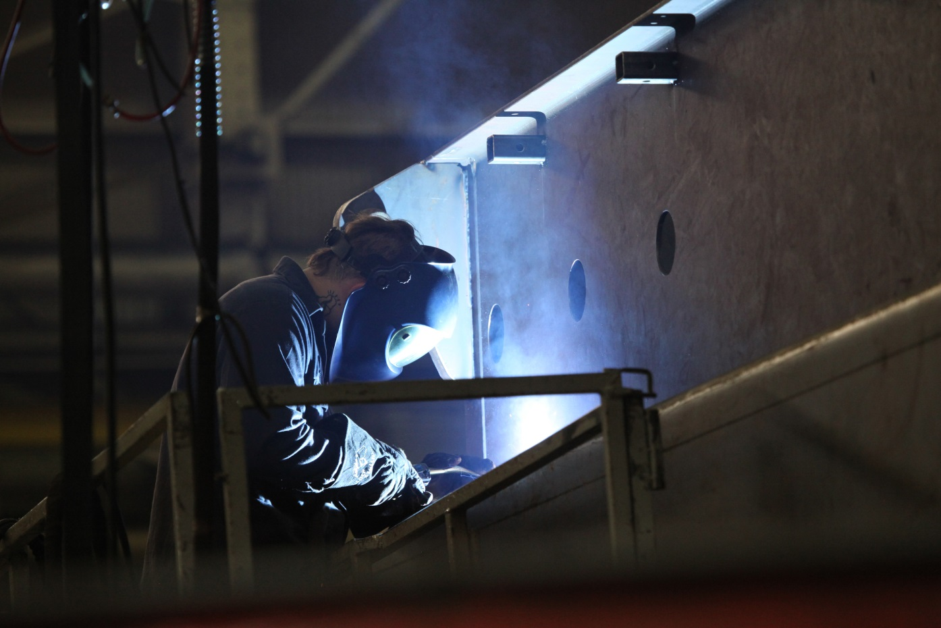
Tanks
Tank Manufacturing
Wrapped/Rounded Corners Standard
Structural Base is Standard

Slide 30
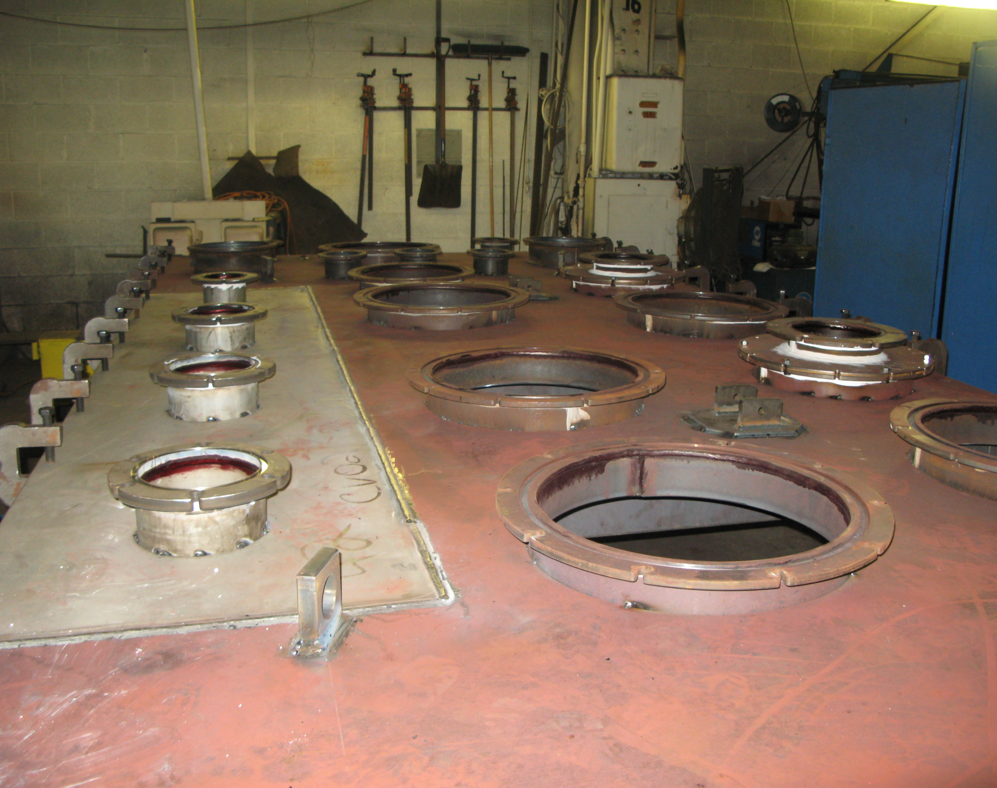
Tanks
Stainless Steel Inserts near High-Current LV Bushings
Determined by FEA Analysis

Slide 31
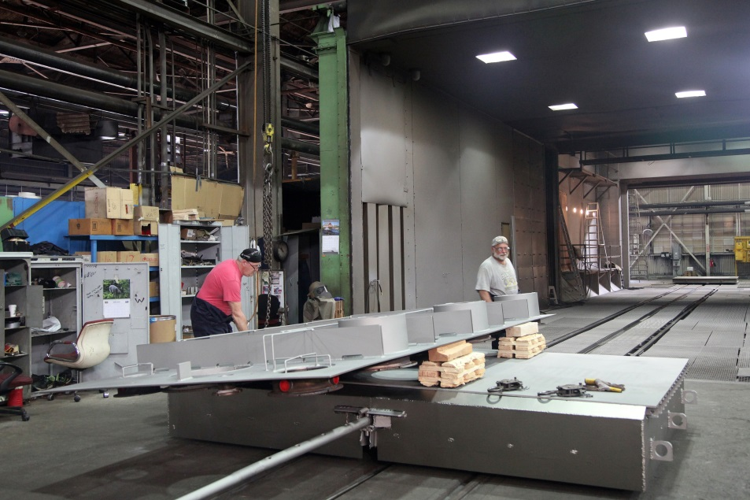
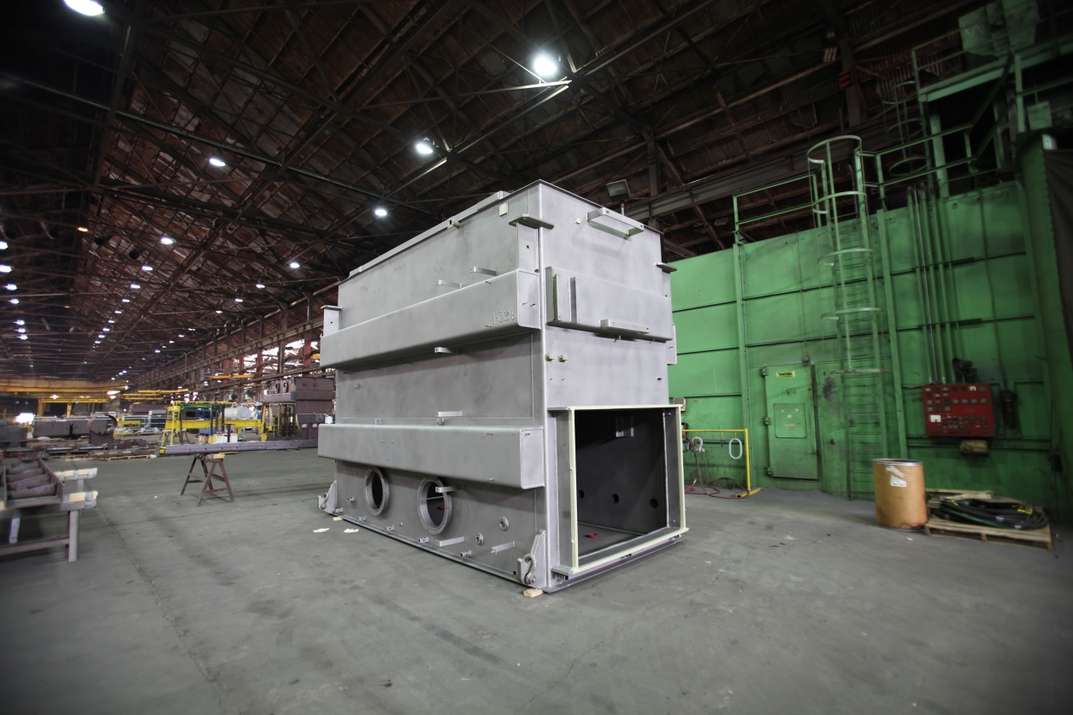
Shot Blasting

Slide 32
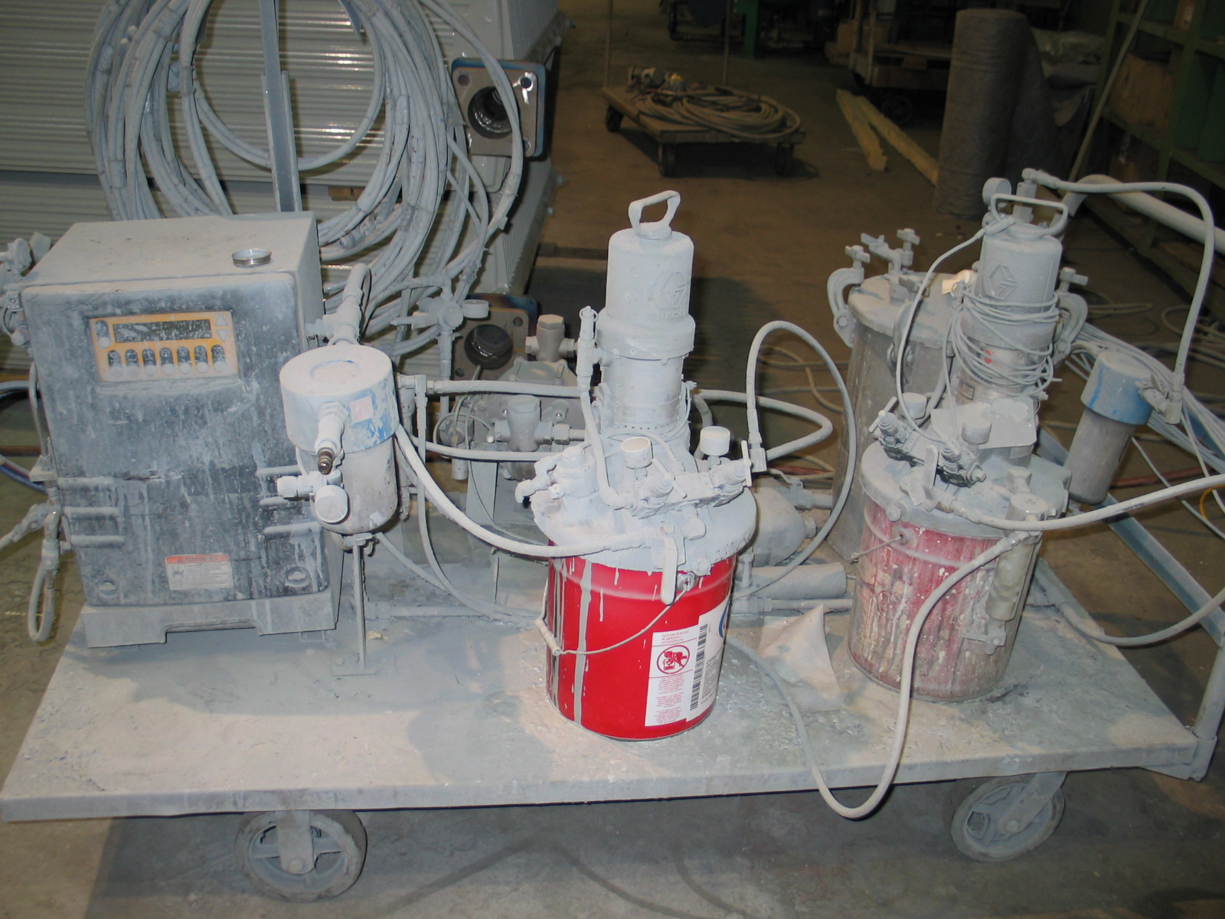
Painting
PTTI meets ANSI C57.12.28
paint standard for pad mounts.
Primer - Zinc Rich Epoxy
Top Coat -
Polyurethane 5mils

Slide 33
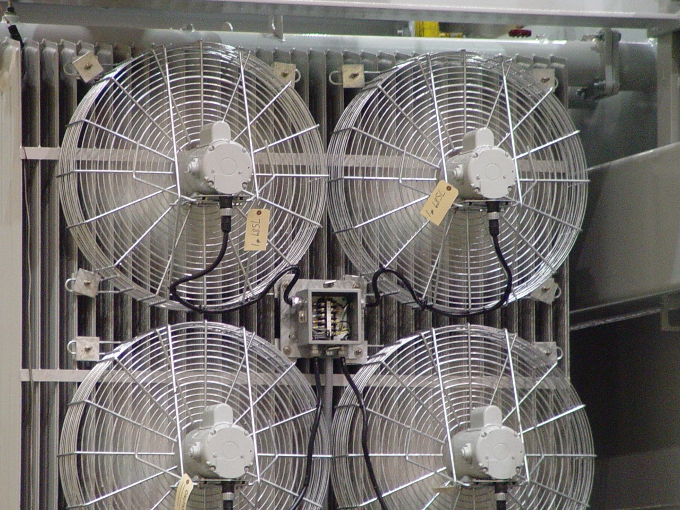
Radiators
Galvanized Radiators
PTTI Fan- Krenz interchangeable

Slide 34
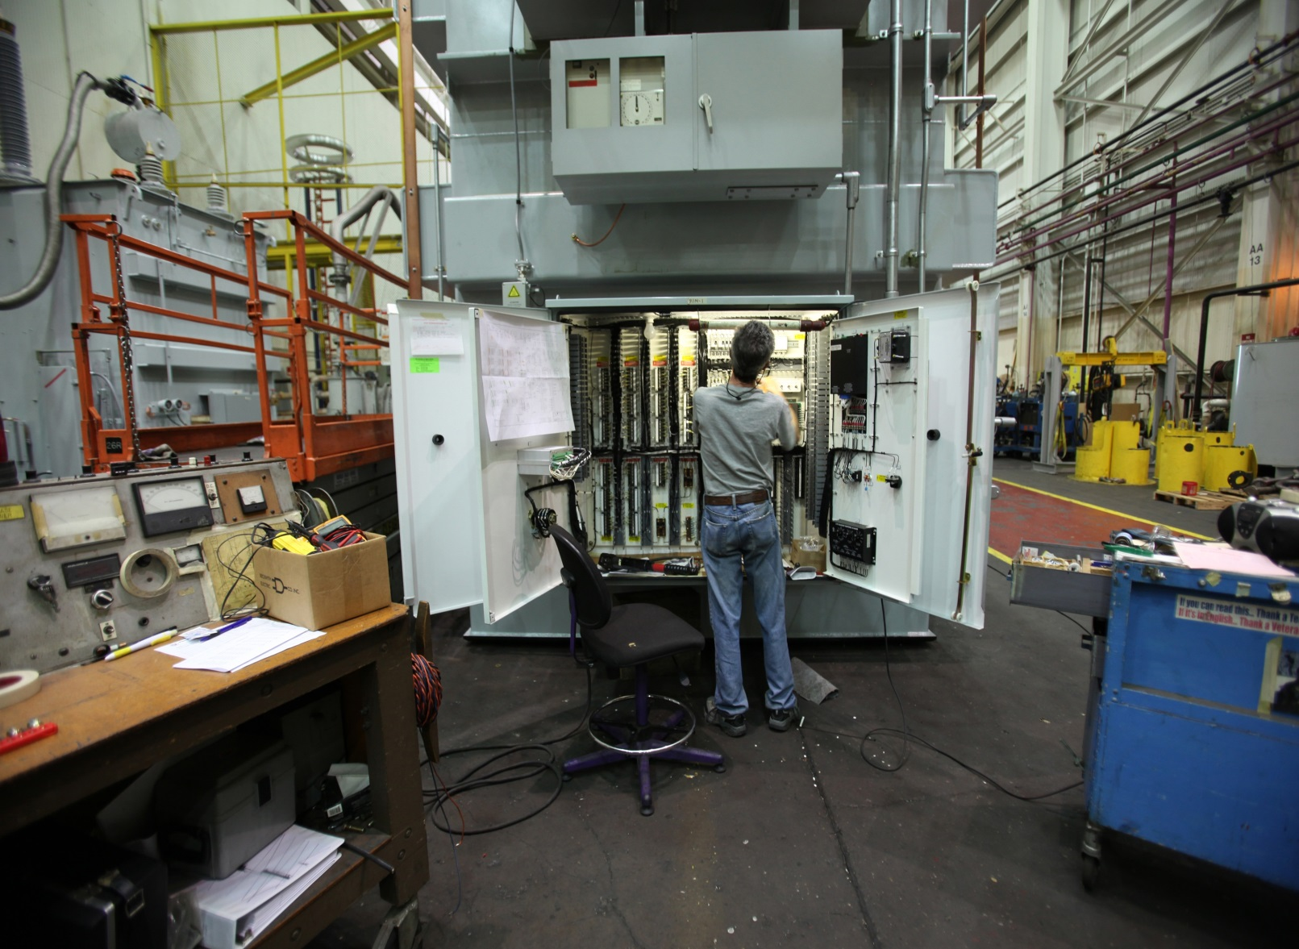
Wiring
Cabinet Shell is Purchased Outside
Cabinets are Wired In-House

Slide 35
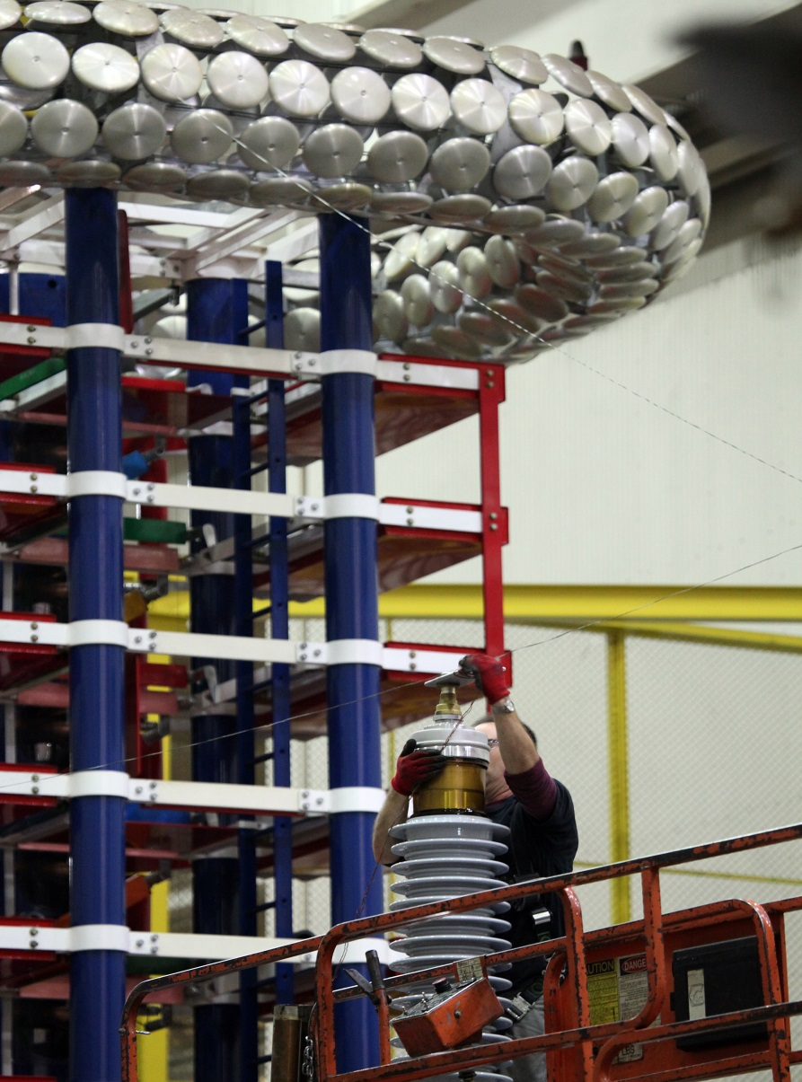
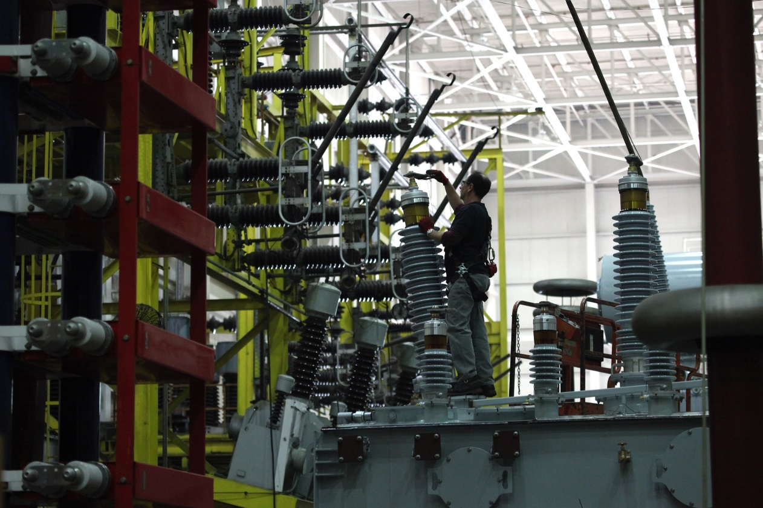
Testing and Shipping
Impulse Generator
Designed for 500 kV transformers
300 kJ / 2,400 kV BIL

Slide 36
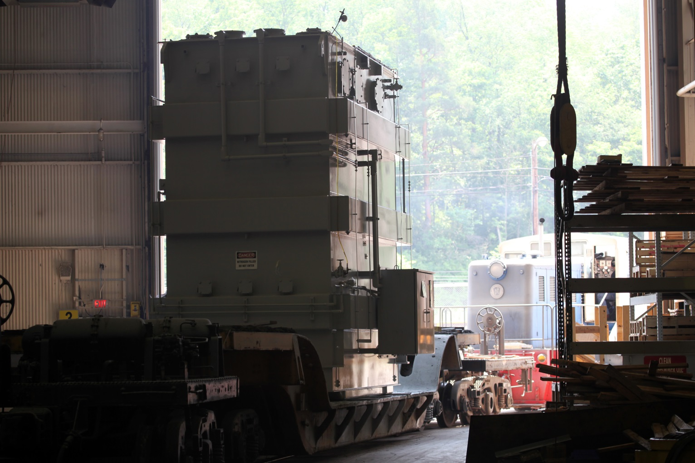
Final Paint
Finished product
Final coat of paint last task before shipment
All copper grounding is painted

Slide 37
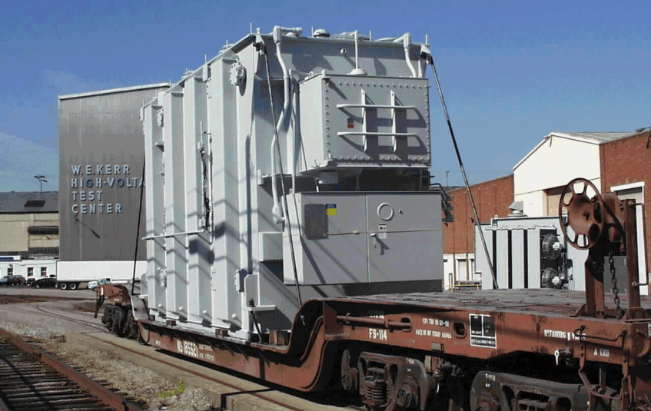
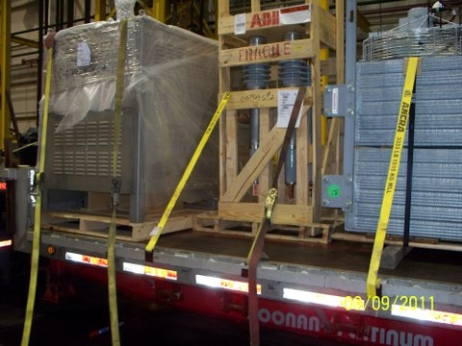
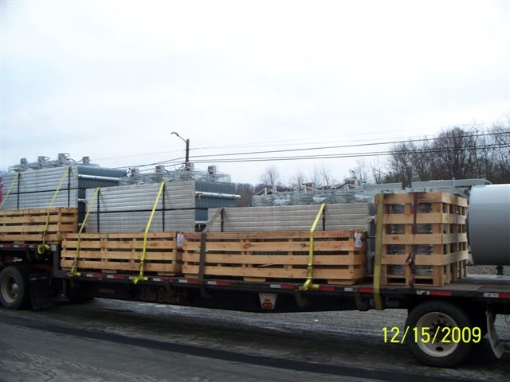
Testing and Shipping
Truck Shipment
< 130,000 lbs
< 170 inches

Slide 38
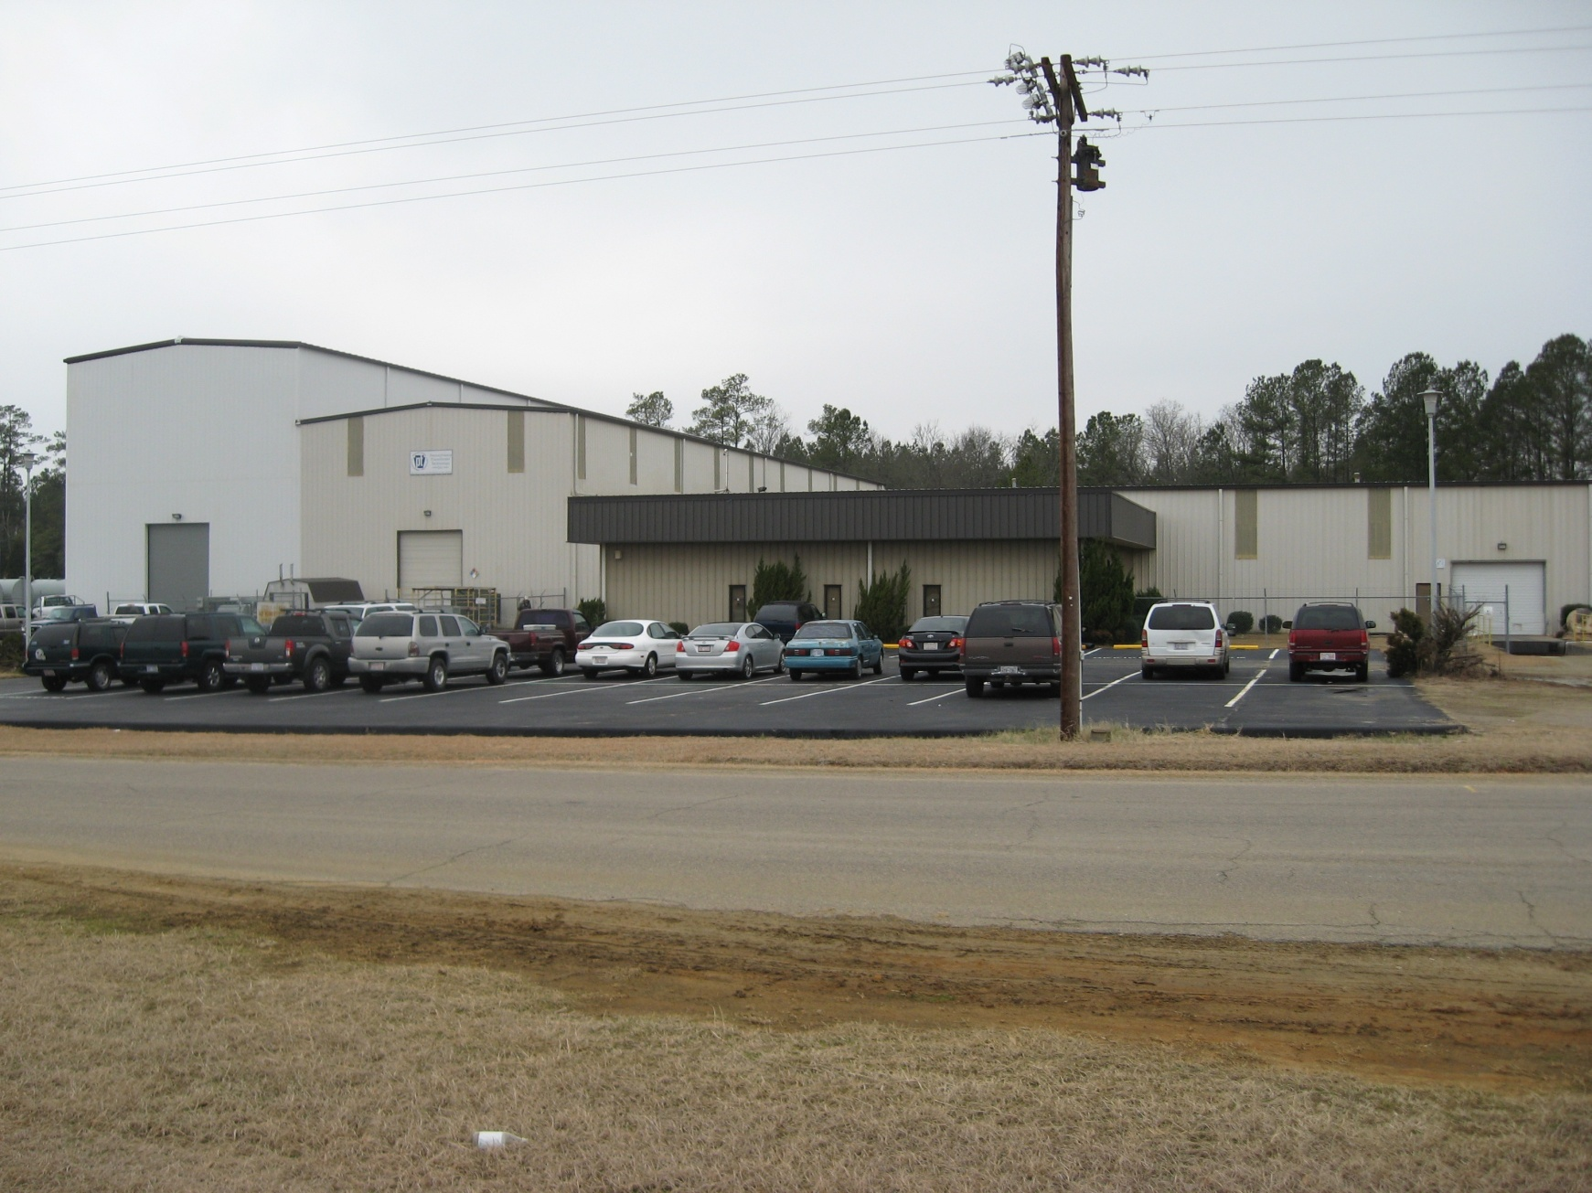
Capabilities – Raeford Specific
Ratings
Maximum Voltage Rating – 161kV
Maximum BIL – 650kV
Maximum Power - 24MVA (base rating)
60 Ton Crane

Slide 39
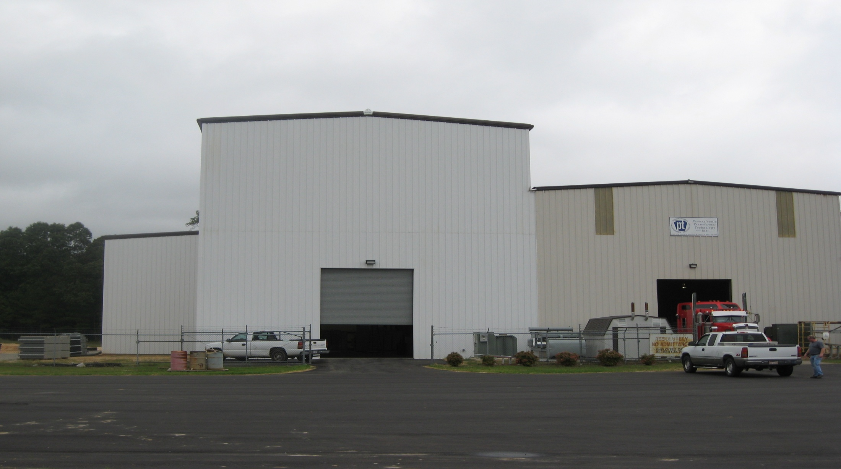
Raeford Investments
Personnel Additions
New Test Engineer
Masters in Power Engineering
Decades of Transformer Test Experience
New QA Manager
Implementing Canonsburg QA Program

Slide 40
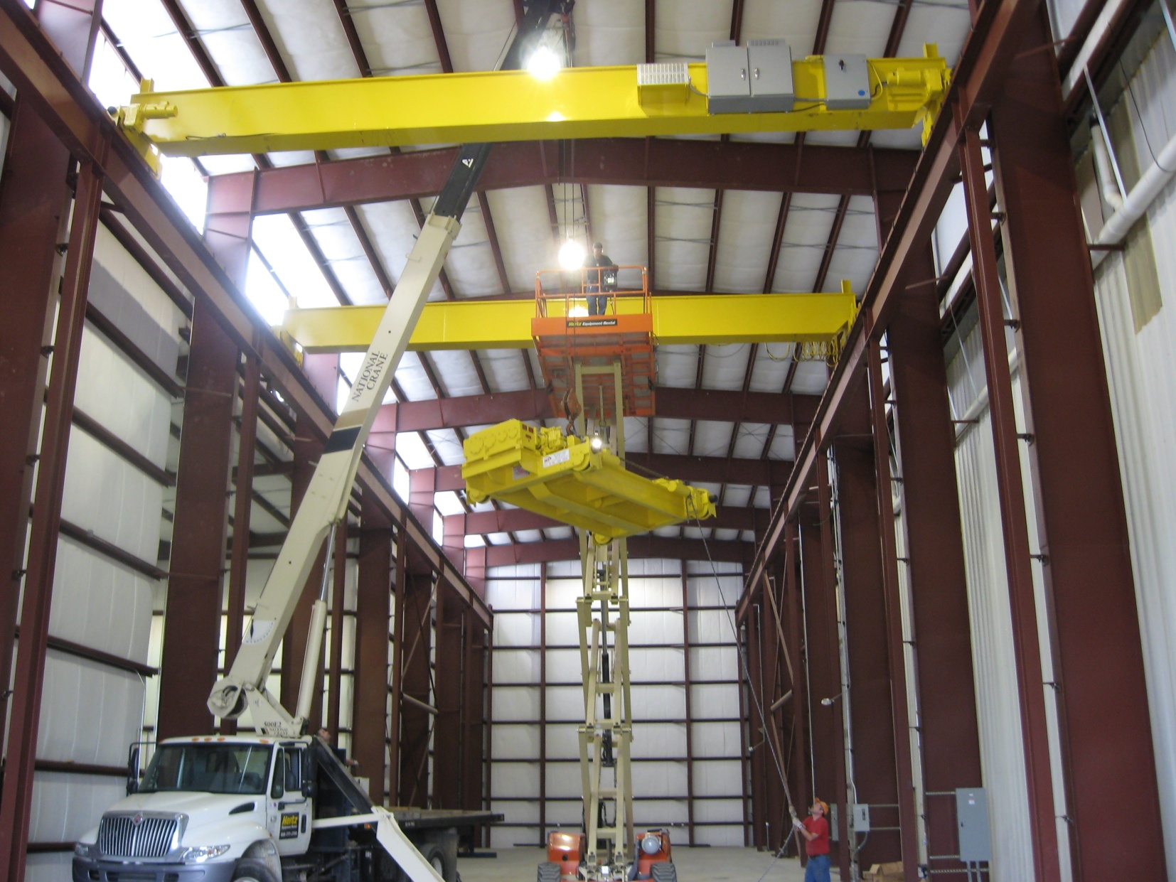
Raeford Investments
Facility Upgrades
High Bay

Slide 41
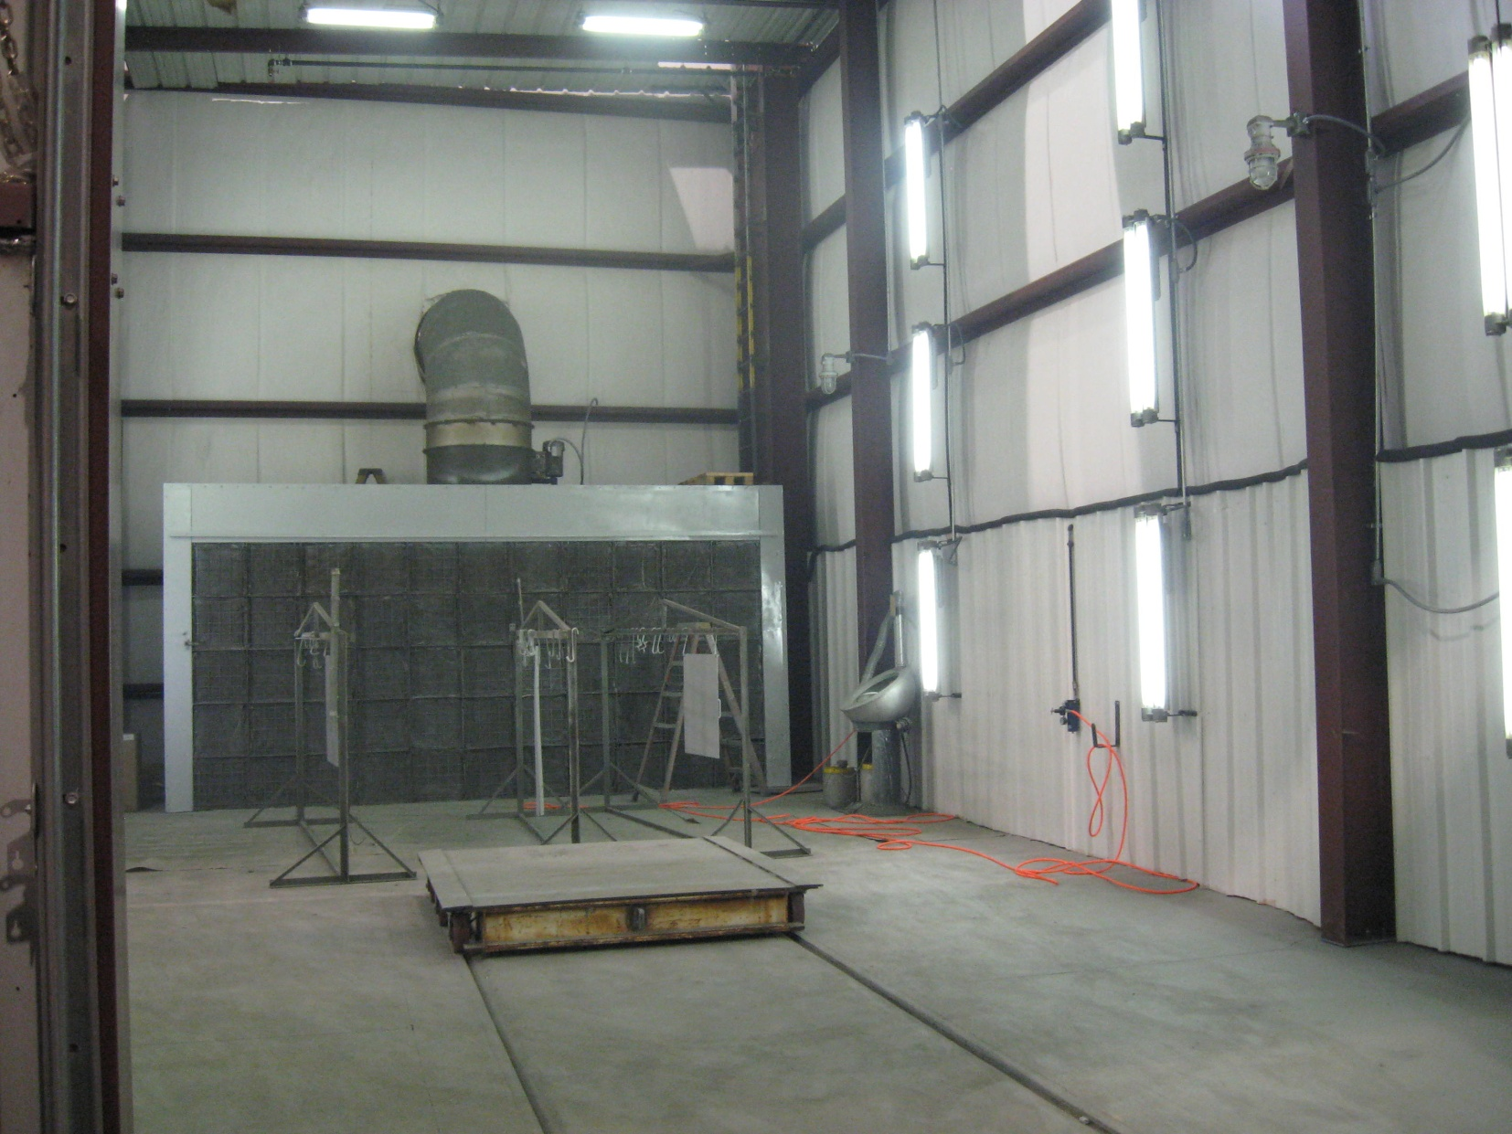
Raeford Investments
Facility Upgrades
Paint Room

Slide 42

Raeford Investments
New Production Equipment
Vapor Phase Autoclave

Slide 43




Raeford Investments
New Production Equipment
Test Equipment
Induced/Corona
Impulse Scope
Loss Measurement

Slide 44
44

